Slide 1
DuoZone: A User-Centric, LLM-Guided Mixed-Initiative XR Window Management System
Jing Qian*¹, George Xi Wang*², Xiangyu Li³, Yunge Wen², Guande Wu⁴, Sonia Castelo², Fumeng Yang⁵, Claudio Silva²
1 Tongji University 2 New York University 3 miHoYo 4 Amazon 5 University of Maryland
* Equal contribution · ISMAR 2026 IEEE TVCG journal track
Notes:
[George]
Hello, I'm George Xi Wang, currently a PhD student at Stony Brook. Together with my co-first author Jing Qian from Tongji University, we will present DuoZone, a user-centric, LLM-guided, mixed-initiative XR window management system. This is joint work with Xiangyu Li, Yunge Wen, Guande Wu, Sonia Castelo, Fumeng Yang, and Claudio Silva.

Slide 2
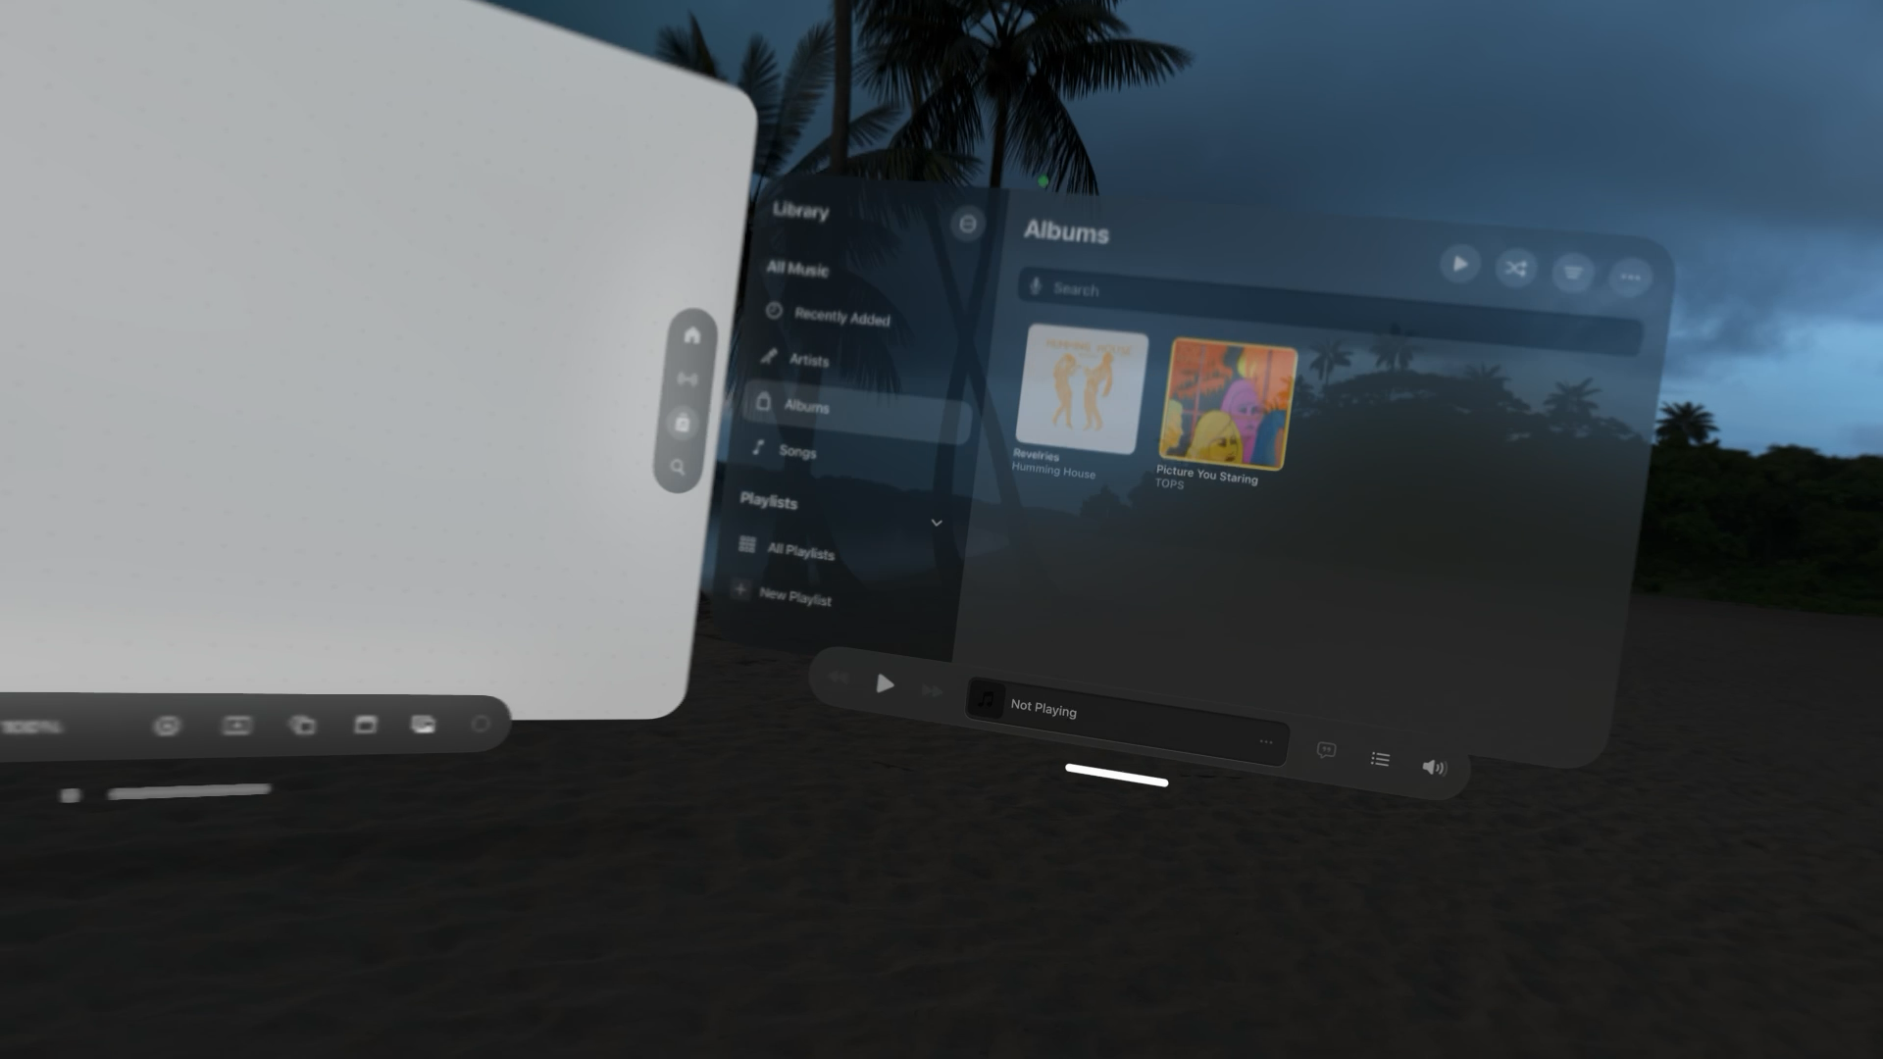
Window management in XR is still manual
1
Even moving or resizing one window takes effort
The effort and physical load compound
2
Little automation for layout adjustment
Prior systems adapt windows to the environment,
not their sizes and positions
3
Virtual windows occlude the real world
Native visionOS manipulation in our study (first-person view)
Surrounding safety and awareness concerns
Research question How can we design an XR window layout management system that improves user performance and reduces user effort?
Notes:
[George]
Lightweight, high-quality XR headsets promise a new kind of portable work: a large, private canvas with as many windows as you like, without carrying physical screens. But three challenges show up,
First, even a simple action, like moving or resizing one virtual window, takes real effort in XR: you point in mid-air, move your arm, and turn your head. That effort compounds when you set up a whole workspace.
Second, there is little automation for layout adjustment. Systems such as SituationAdapt adapt windows to the environment, but they do not decide how large each window should be or where it goes.
Third, virtual windows occlude the physical world, which raises safety concerns and limits awareness of your surroundings.
So our question was: how can we design an XR window layout management system that improves user performance and reduces user effort?

Slide 3
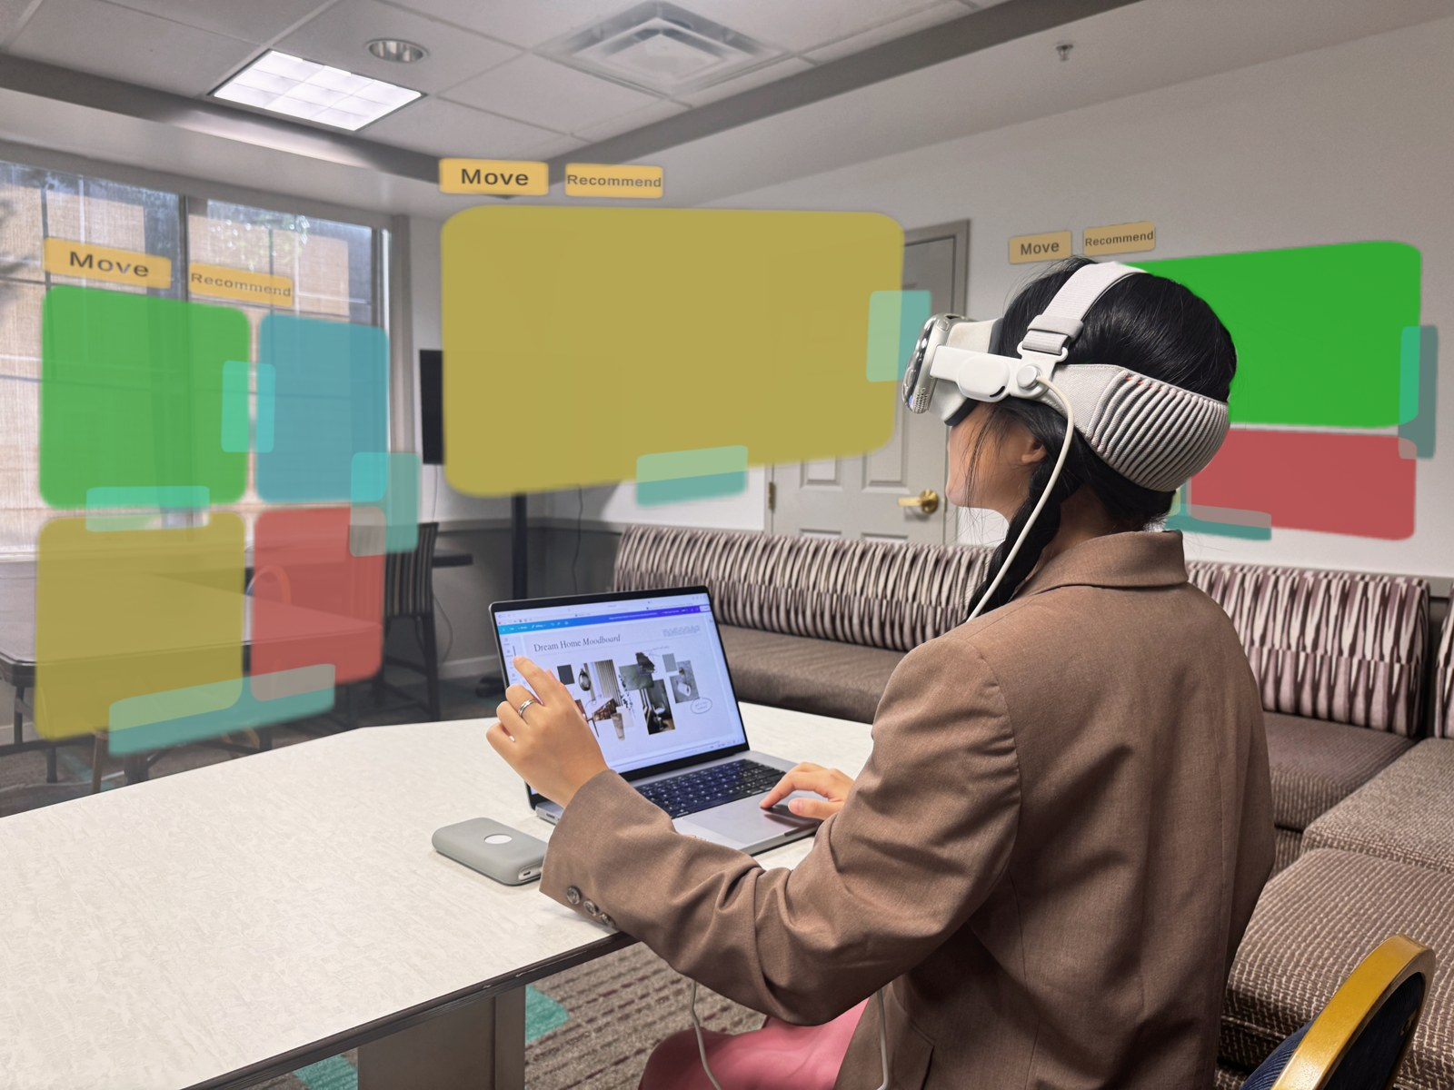
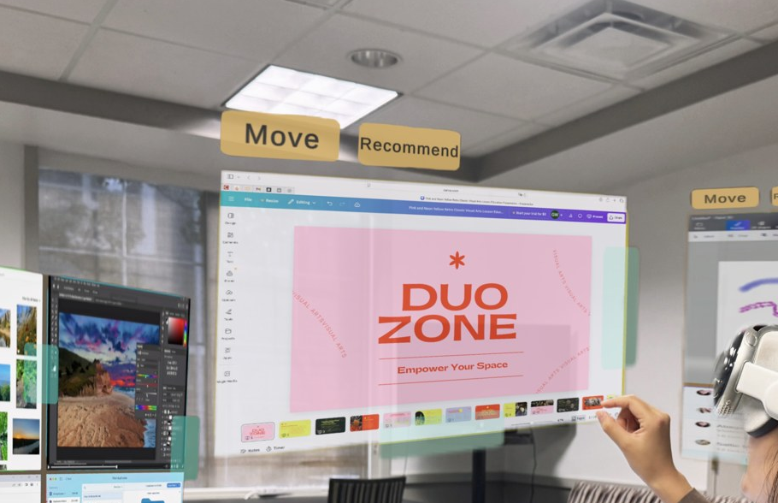
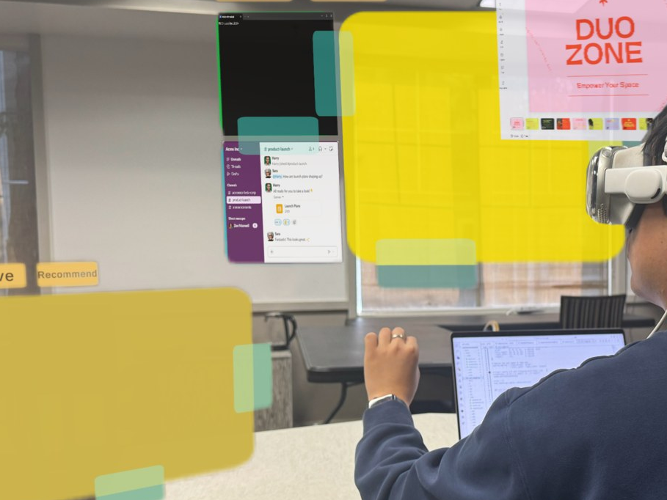
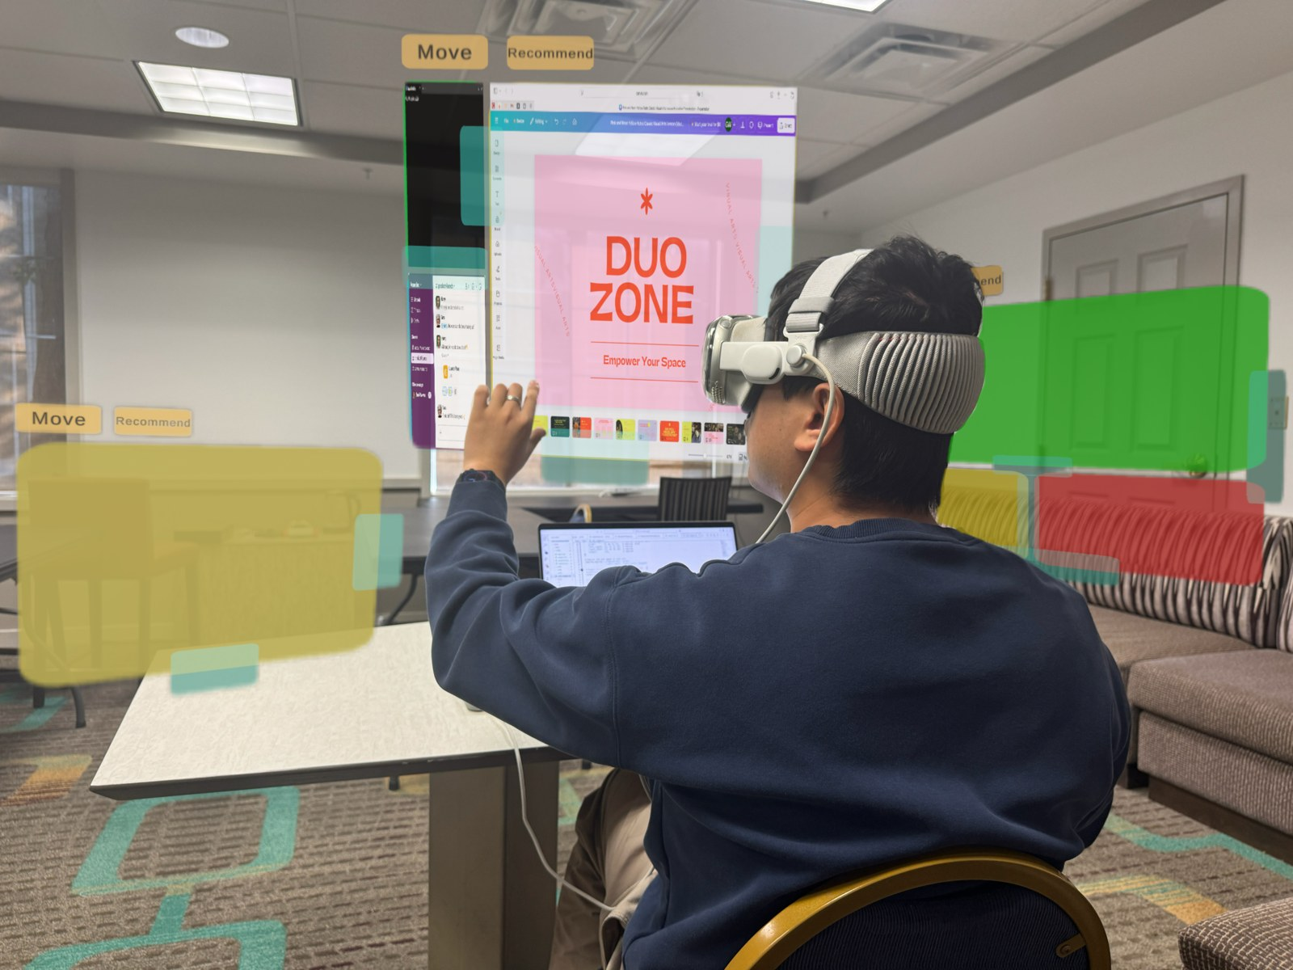
DuoZone: user authors, AI scaffolds, user refines
Recommendation Zone
Recommendation Zone
1 User authors zones
Spatial layout templates mark where automation may act
2 AI scaffolds
Setting up zones
Goal-based auto-planning
An LLM recommends and assigns apps
a cost model then orders and sizes apps
Arrangement Zone
Arrangement Zone
3 User refines
Accept, reorder, resize
The final workspace is always the user's
Zones are the explicit boundary between human intent and AI automation.
Establishing layout space
Drag, resize, snap
Notes:
[George]
Our answer is DuoZone, in one sentence: the user authors, the AI scaffolds, and the user refines. Users first author spatial zones. A zone is one of the translucent, colored layout templates floating in these photos; it defines where automation may act, and everything outside stays manual.
There are two kinds. Arrangement Zones, on the bottom row, are purely manual: they let you snap, group, resize, and move several windows together as one unit.
Recommendation Zones, on the top row, add automation on top of the same structure. You give a high-level goal, a large language model recommends and assigns applications to the cells, and a cost model adjusts their ordering and sizing. The user then refines the result. The key idea: user-authored zones are the explicit boundary between human intent and AI automation. People decide where the AI may work; the AI fills in the details.

Slide 4
Three contributions
1
2
3
A user-authored zone abstraction
The DuoZone system
Evidence from three comparisons
Spatial layout templates for XR window management and workspace planning
An LLM's reasoning combined with a geometric and ergonomic cost model to recommend, order, and size apps.
Improved performance for recommendation zones
Recommendation zones provides an efficient human-AI workflow to jump start XR workspace setup
Notes:
[George]
We make three contributions. First, a user-authored zone abstraction for XR window management and workspace planning. Second, the DuoZone system, which combines an LLM's semantic reasoning with a geometric and ergonomic cost model to recommend, assign, order, and size applications within those zones. Third, empirical evidence supporting Improved performance for recommendation zones and Recommendation zones provides an efficient human-AI workflow to jump start XR workspace setup

Slide 5
Design goals
DG1
Speed and low effort through spatial anchors
DG2
human-AI collaboration
Manipulating windows in 3D is slower than in 2D. Anchors, snapping, and grouping cut repeated mid-air pointing and large arm movements.
Mixed-initiative: AI scaffolds, the user completes.
DG3
Dynamic readability
DG4
An occlusion-free area
Bigger windows read better but cost more head and hand movement. Keep related windows adjacent and every cell above a legibility floor of 0.5° visual angle.
A configurable see-through region that stays clear of virtual content, with a warning when interfaces intrude.
Notes:
[George]
Four design goals shaped the system. First, speed and low effort: manipulating windows in 3D is slower than in 2D, so we use spatial anchors, snapping, and grouping to cut repeated mid-air pointing and large arm movements. Second, a human-AI collaboration with a mixed-initiative strategy, where the AI scaffolds and the user refines the results. Third, dynamic readability: larger windows read better but cost more head and hand movement, so related windows should sit close together, and every cell must stay above a legibility floor. Fourth, an occlusion-free area that stays clear of virtual content so part of the real world remains visible.

Slide 6
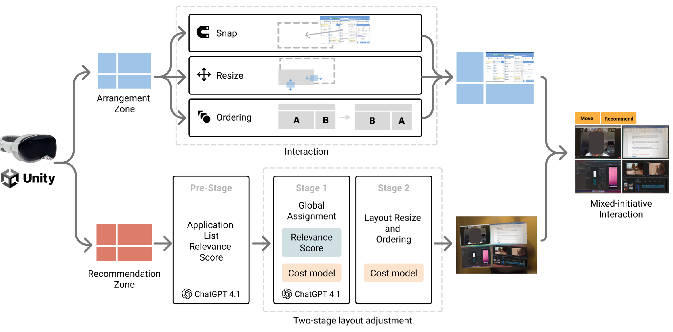
System overview
Notes:
[George]
Here is the system at a glance. From the headset there are two paths. On the top path, Arrangement Zones, in blue, support snapping, resizing, and ordering through direct interaction, with no AI involved. On the bottom path, Recommendation Zones, in red, run a three-step pipeline. A pre-stage asks ChatGPT 4.1 for relevant applications with relevance scores. Stage one asks the LLM for a global assignment of those apps to cells, informed by our cost model. Stage two runs the cost model alone to resize and reorder each zone. Both paths end at the same place on the right: a mixed-initiative interaction where the user can accept the result or edit any part of it.

Slide 7
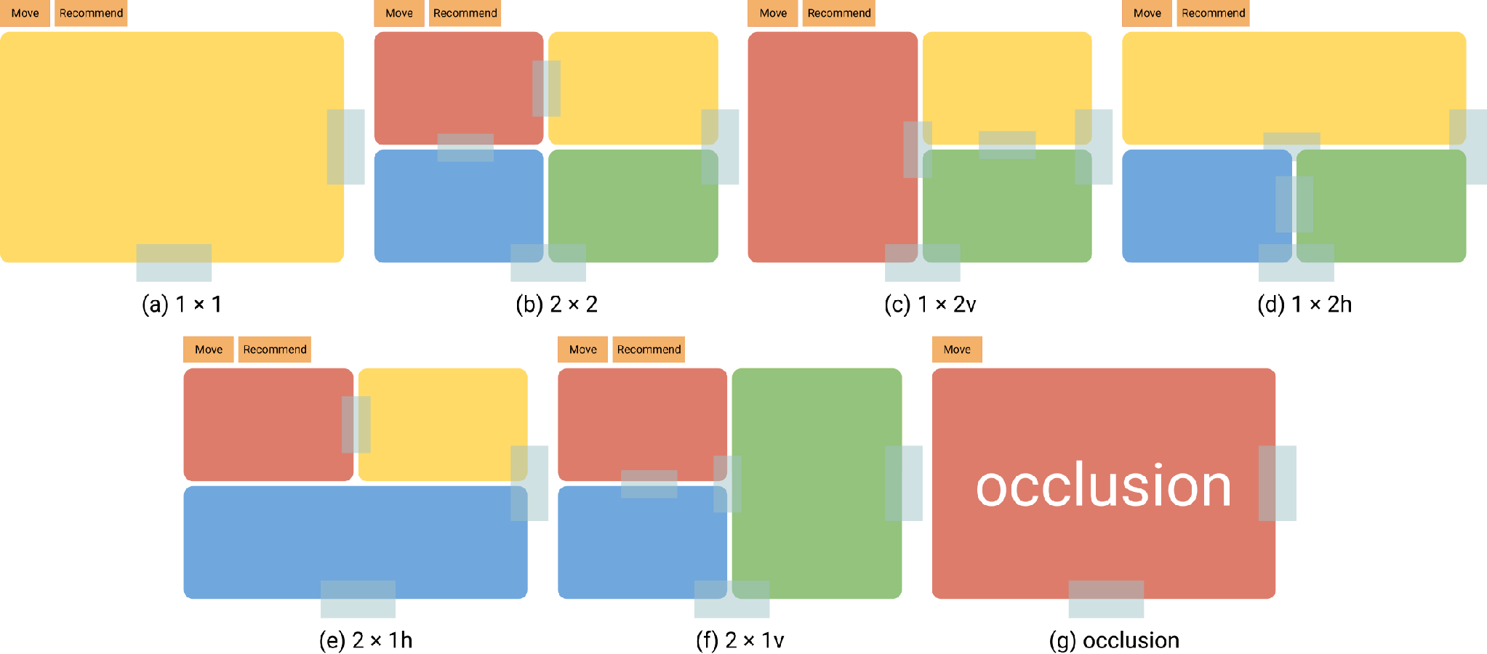
Arrangement Zone: layout templates as 3D spatial anchors
Six tiled templates
1×1, 2×2, 1×2v, 1×2h, 2×1h, 2×1v
Translucent containers
Adjust inner cells, overall size, and position. Drop a window on a cell and it snaps.
Occlusion template
A see-through 1×1 void. A red contour warns when another zone intersects it.
Inside a zone: semi-automatic organization (snap, align, group)
Notes:
[George]
Let us look at Arrangement Zones first. They are translucent, window-like containers that float in the room. Extending the tiled-window convention people know from desktop systems, we provide six layout templates.
Users can compose these into more complex layouts. Each zone can be adjusted in three ways: its inner cells, its overall size, and its position in space.
Inside a zone, organization is semi-automatic: drop a window on a cell and it snaps into place. Outside the zones, everything stays under full manual control.
Finally, a special occlusion template, at the bottom right, marks a see-through void where no virtual content should go. If another zone intersects it, a red contour warns the user.

Slide 8

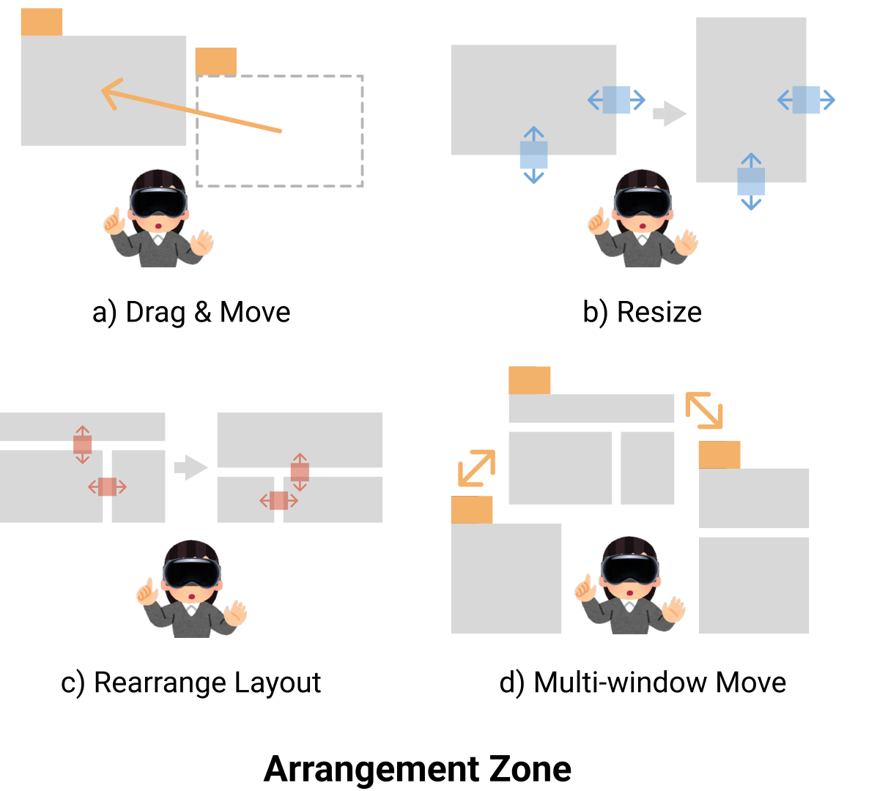
Arrangement Zone interactions
Participant snapping and moving windows (Task 1, Arrangement Zones)
Gaze-targeted pinch (visionOS SpatialPointer) drives drag start and end, taps, and hover
A cell highlights on hover to announce the snap that follows
Notes:
[George]
Interaction follows the familiar drag-and-drop. As the four diagrams show, users drag and move windows into cells, resize zones with edge handles, rearrange the layout, and move a whole zone with all of its windows as a group. One technical detail matters here. On visionOS, apps do not get continuous eye-tracking data; the system only reports a pointer at the moment of a pinch. So we use those pinch events for state changes: drag start, drag end, taps, and hover. When a dragged window hovers over a cell, the cell highlights to announce that a snap will follow, so the user always knows where the window will land. On the right you can see a participant in our study snapping and moving windows this way.

Slide 9
Recommendation Zone: from a spoken goal to a workspace
Goal by voice
Pre-stage: LLM proposes apps
Stage 1: global assignment
Stage 2: per-zone layout
User confirms or edits
Wit speech-to-text; the transcript is editable
ChatGPT 4.1 returns app names with relevance scores in [0, 1]
The LLM places apps into cells, guided by a cost matrix
Cost model sets dividers, sizes, order; scale-up to 0.5° legibility
Users may adjust the app or zones like adjustment zones
Study participant requesting and confirming an AI layout (Task 2)
Notes:
[George]
Recommendation Zones add automation on top of the same zones, and the pipeline across the top shows the five steps. First, the user speaks a high-level goal, for example 'set up for coding a web game’. Our system converts speech to text, and the transcript can be edited. Second, in the pre-stage, ChatGPT returns recommended applications. Third, in stage one, we compute a cost matrix from the current zone geometry and ask the LLM for a global assignment of apps to cells across all zones. We use the LLM here because it can weigh trade-offs that are hard to encode, such as keeping email next to the calendar. Fourth, in stage two, every zone independently optimizes its internal layout: divider positions, cell sizes, and app order. If the smallest cell falls below the legibility threshold, the zone scales up. Importantly, we never move a user-authored zone. Positions stay fixed to preserve the spatial mental model; only content and sizes change.

Slide 10
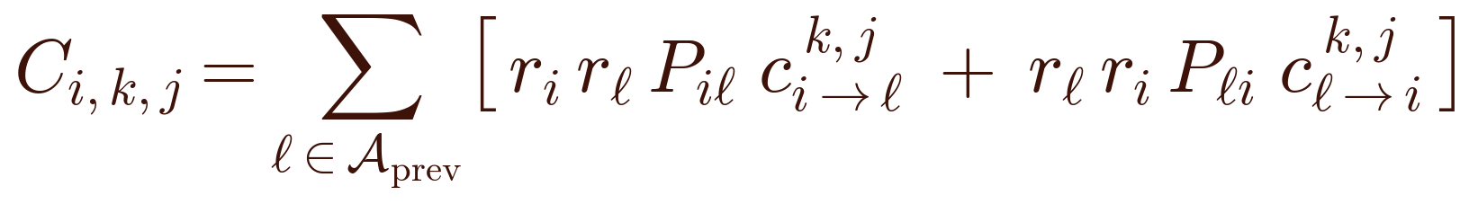
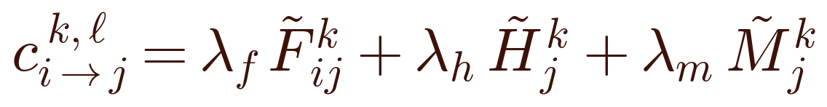
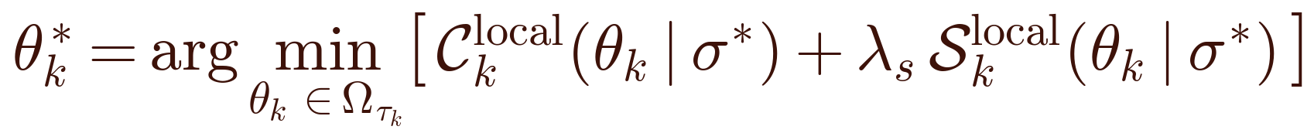
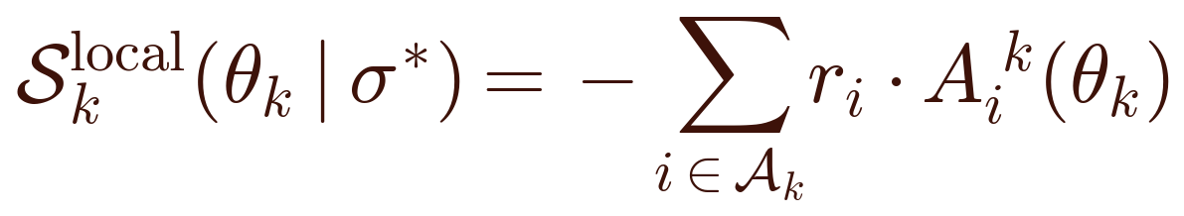
The cost model: cheap to reach, easy to read
Pointing distance
Stage 1: cost of placing app i in cell (k, j)
F
Euclidean distance between two apps' cell centers (zone centers across zones).
H
Head-turn angle
Angle between the forward view and the direction to the app.
Sum over already placed apps ℓ of the transition cost, weighted by joint relevance r·r and the user's transition frequency P. The LLM receives this matrix and decides the assignment.
M
Hand-movement distance
Stage 2: each zone picks its divider point θ
Hand displacement between pointer-down and pointer-up during direct manipulation.
Normalized to [0, 1] with ergonomic min–max ranges.
Equal weights: a pilot by two authors showed that tuning per-signal weights on limited data overfits.
Transition frequencies are learned per user from app-switching history, starting uniform for a new user.
Minimize intra-zone transition cost while giving more area to more relevant apps (the S term). Then scale the zone up until its smallest cell meets the 0.5° legibility floor.
For details, please refer to our paper
Notes:
[George]
Let me explain the cost model at a high level. It uses three signals, all measured in the headset. F is the pointing distance: how far the pointer travels between two apps' cell centers. H is the head-turn angle: how far you must turn your head to bring an app into view. M is the hand-movement distance between pointer-down and pointer-up. Each signal is normalized to a zero-to-one range using ergonomic limits, and we use equal weights, because a pilot showed that fitting individual weights on limited data overfits. The equations on the right show how the signals are used. In stage one, the cost of placing an app in a cell sums the transition costs to apps already placed, weighted by how relevant both apps are and how often the user switches between them. In stage two, each zone chooses the divider point that minimizes intra-zone transition cost while giving more area to more relevant apps, then applies the readability scale-up.

Slide 11
Ablation: the cost model makes LLM layouts usable
Setup
160 paired workspaces across design and engineering scenarios. Two independent raters (Cohen's κ = .61), paired Wilcoxon signed-rank tests.
Relevance: no difference
Recommended apps were equally relevant: 4.18 (SD 0.62) vs 4.11 (SD 0.69).
Sizing and placement: 4.06 vs 2.76
W = 342.0, p < .001. Pure LLM placement and sizing were far less functional.
Readability: 3.98 vs 2.79
W = 245.0, p < .001. The pure LLM often shrank apps below legibility for no clear reason.
Mean rater score, 5-point Likert scale, 160 paired workspace setups
Notes:
[George]
We ran an ablation on 160 paired workspaces across design and engineering setups: pure LLM, which also did placement and sizing, versus our full pipeline with the cost model. Two independent raters, with moderate agreement, scored relevance, readability, and functional sizing on a five-point scale. As the chart shows, app relevance was equally high in both conditions, because the same LLM chooses the apps. But sizing and placement dropped from 4.06 with the cost model to 2.76 with the pure LLM, and readability dropped from 3.98 to 2.79, both highly significant. The pure LLM often shrank apps below legibility for no clear reason. The LLM picks good apps; the cost model makes the layout usable.

Slide 12
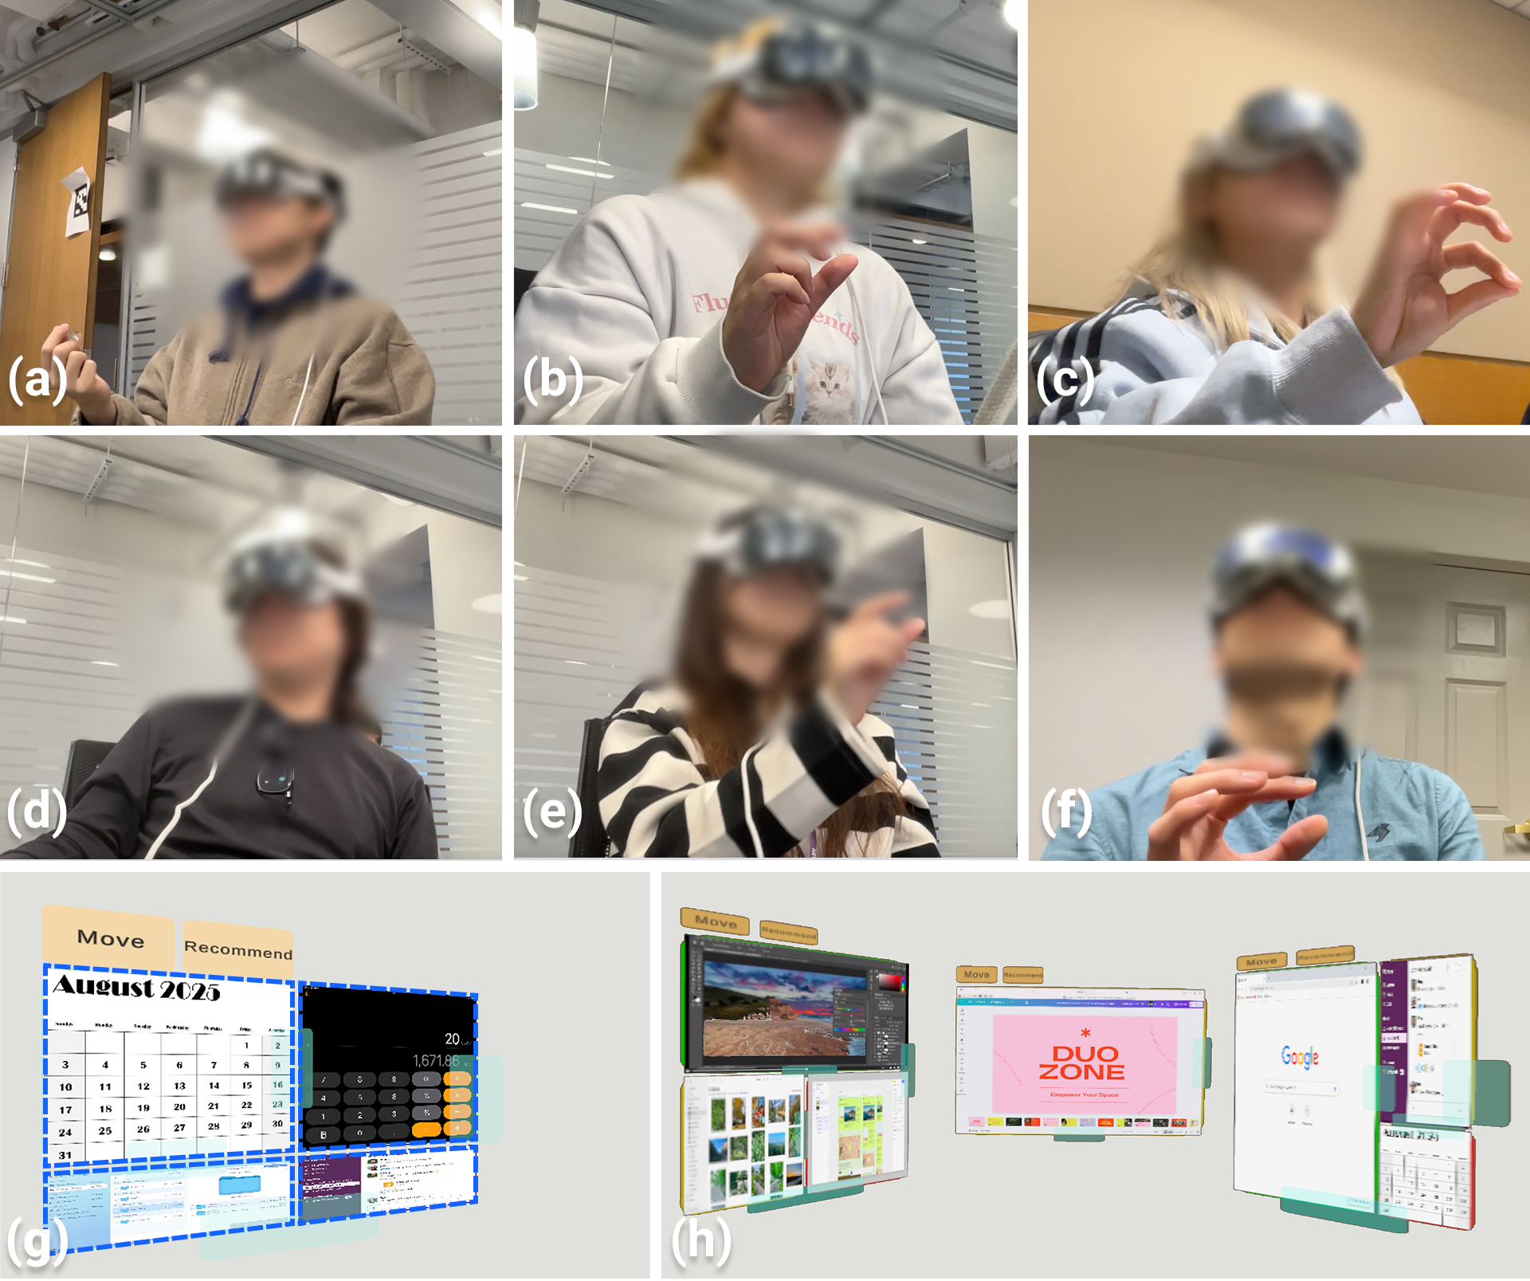
User study: 16 experts, two tasks, two comparisons
Participants
N = 16 (8 women, 8 men), 21–39 years (M = 26.7). At least 3 years of professional experience, daily multi-window work; 15 had prior XR experience.
Apparatus
Apple Vision Pro (1st gen) running the Unity/PolySpatial client; an RTX 4050 host runs the AI pipeline over the local network.
Task 1: layout matching
15 trials per condition. Drag 3–4 panels to match a holographic target in one of five directions. Native visionOS manipulation vs. Arrangement Zones, counterbalanced.
Task 2: workspace construction
Set up a workspace to design a poster or code a demo. Zones-only manual setup vs. Recommendation Zones. Baseline always first, so the LLM could not prime manual choices.
(a–f) participants; (g) Task 1 layout matching; (h) Task 2 workspace construction
Measures
Completion time, NASA-TLX, acceptance of AI proposals, semi-structured interviews. 480 Task 1 trials and 32 complete workspaces.
Notes:
We recruited sixteen experts, eight women and eight men, all with at least three years of professional experience and daily multi-window work; fifteen had used XR before. Everyone wore a first-generation Apple Vision Pro, with a host machine running the AI pipeline over the local network. The study was within-subject, so every participant experienced every condition, and it had two tasks. Task one is layout matching, shown in panel g: a holographic target layout appears in one of five directions around the participant, and they drag three or four app panels to match it. There were fifteen trials per condition, comparing native visionOS manipulation with Arrangement Zones, with the order counterbalanced. T
ask two is workspace construction, shown in panel h: participants set up a workspace they would actually use, to design a poster or to code a demo, comparing zones-only manual setup with Recommendation Zones. Here the manual baseline always came first, so the LLM's suggestions could not prime the manual choices. We measured completion time, workload with the NASA-TLX questionnaire, acceptance of the AI's proposals, and ran semi-structured interviews.

Slide 13
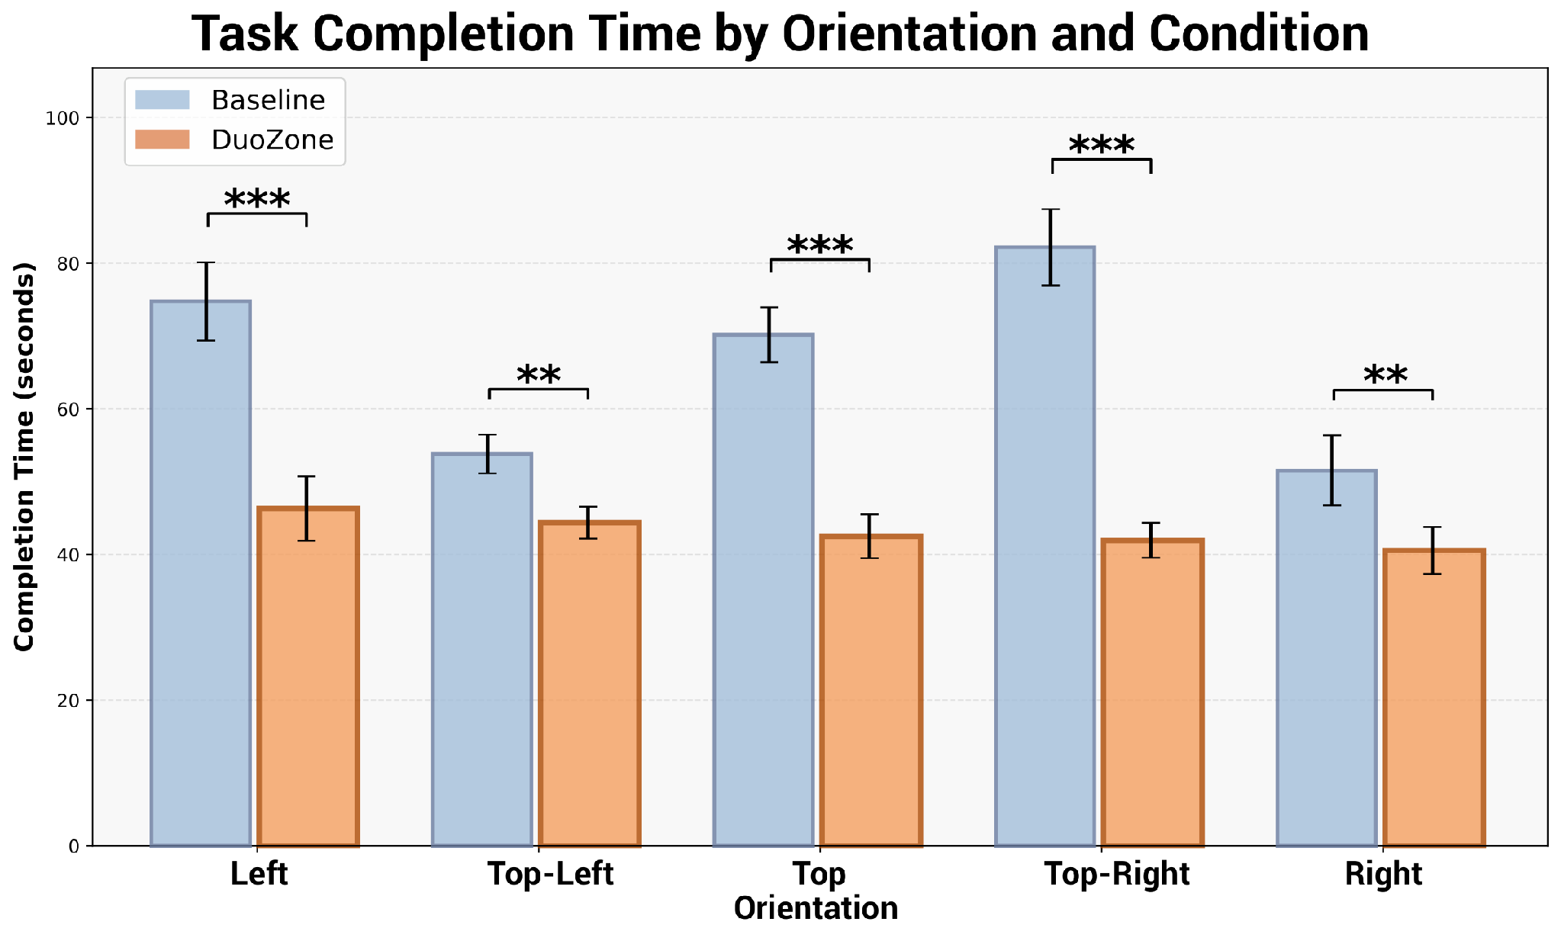
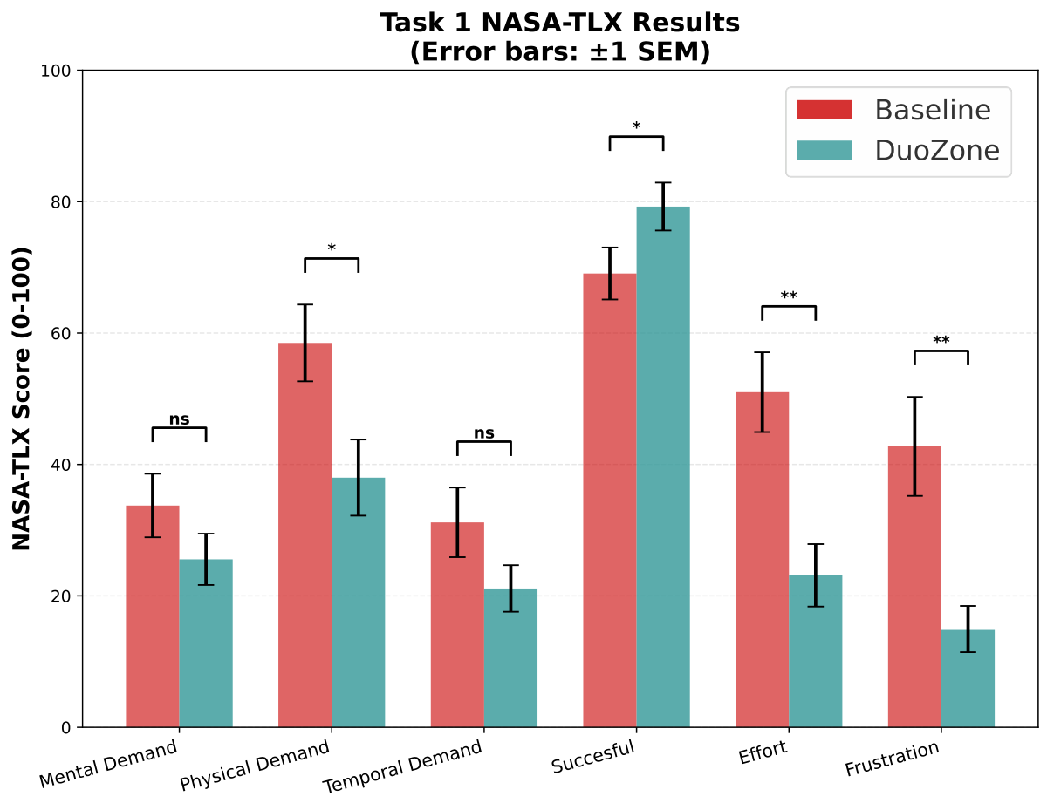
Task 1: Arrangement Zones were 34.5% faster
34.5% faster
TLX 47.7 → 33.3
Direction stops mattering
Notes:
[Jing]
In task one, Arrangement Zones made participants 34.5 percent faster. Because completion times are skewed, we analyzed them on a log scale: the geometric-mean time ratio was 0.655, with a 95 percent confidence interval from 0.566 to 0.757, p below .001. The left chart shows the effect holds in all five target directions. In the baseline, top-right was slowest; with DuoZone, no direction differed, so zones removed the penalty of awkward directions. Workload dropped too: as the NASA-TLX chart on the right shows, overall workload fell from 47.7 to 33.3, with significantly lower physical demand, effort, and frustration, and higher perceived performance.

Slide 14
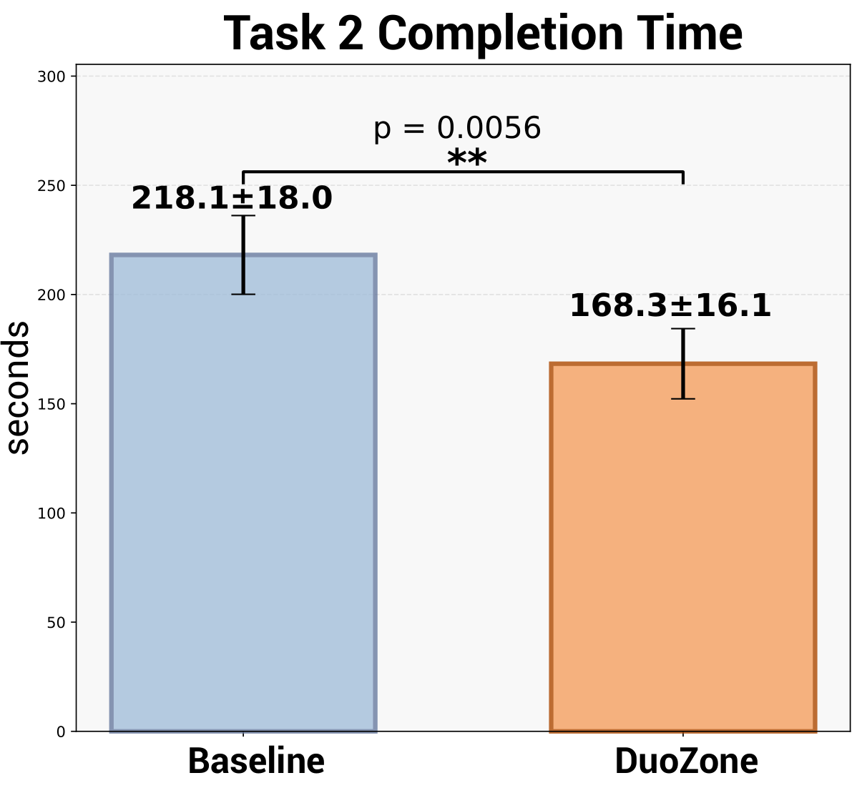
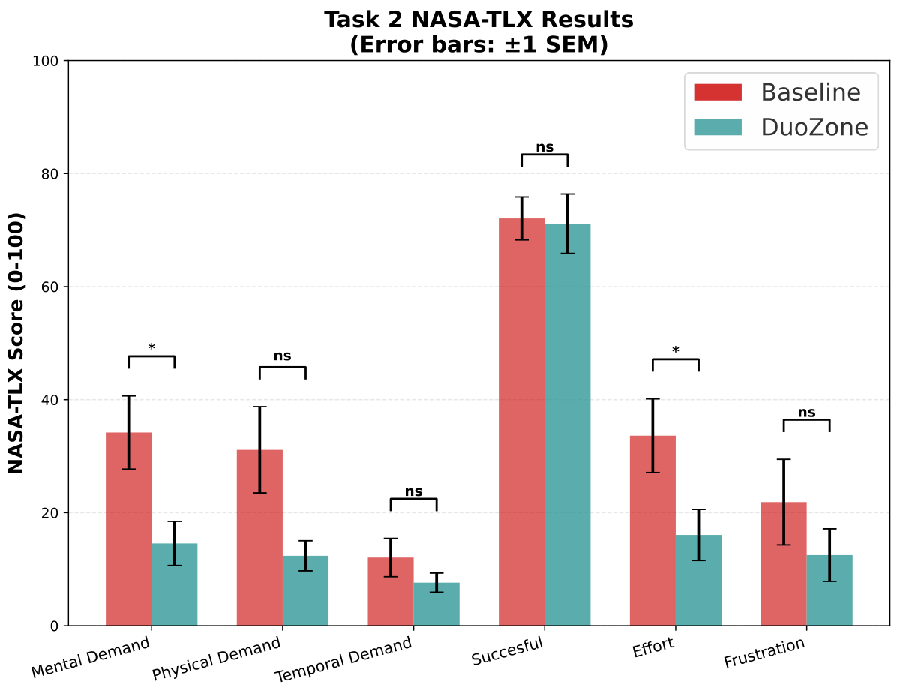
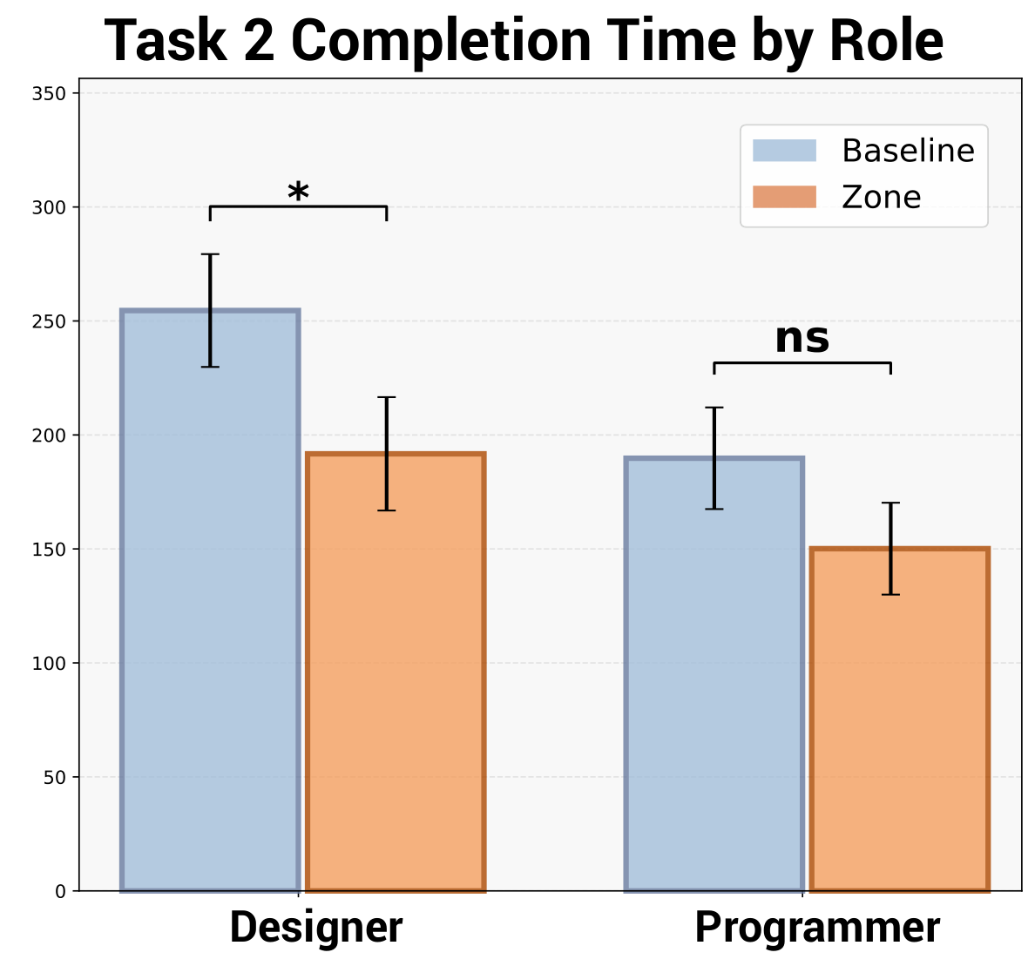
Task 2: AI-assisted setup was 50 seconds faster
218 s vs 168 s
TLX 34.2 → 22.4
Mental demand ↓ Effort ↓
Notes:
[Jing]
In task two, AI-assisted setup with Recommendation Zones took 168 seconds on average, versus 218 seconds for zones-only manual setup. That is about fifty seconds saved on a task that takes a few minutes, and the difference is significant,. Workload fell as well: overall NASA-TLX dropped from 34.2 to 22.4, with significantly lower mental demand and effort, while the other subscales did not differ.

Slide 15
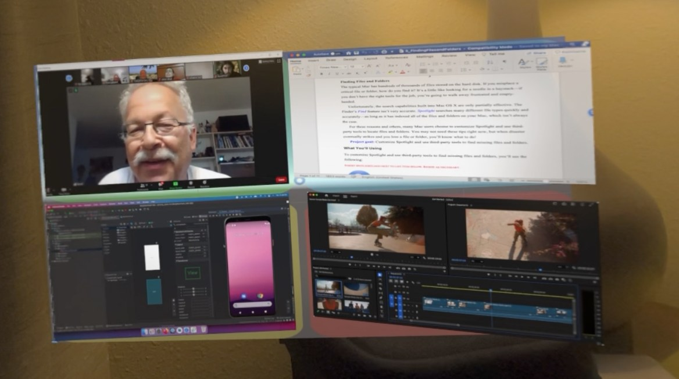
Participants kept most of what the AI proposed
91.7%
82.8%
76.5%
62.5%
recommended apps accepted (121 of 132)
proposed zone layouts kept (53 of 64)
proposed app orderings kept (91 of 119)
sizes kept unchanged
Task 2, 16 workspaces: about 4 zones and 8 recommended apps each; 0.68 apps rejected on average (SD 0.87)
Layout structure and ordering were mostly kept; sizing is where personal preference shows
Satisfaction was the same for manual and DuoZone setups (3.81 vs 3.69, p = .927): automation did not cost perceived quality or expressiveness
AI-generated workspace after confirmation (first-person view)
Notes:
[Jing]
How much of the AI's work survived contact with real users? Participants created about four zones per workspace and received about eight app recommendations. They accepted 91.7 percent of the recommended apps, rejecting only 0.68 apps on average. They kept 82.8 percent of the proposed zone layouts and 76.5 percent of the proposed orderings. Sizing was the weakest part: 62.5 percent of sizes were kept, and 37.5 percent were manually rescaled. So the structure and the choice of apps were right, and what people changed was mostly personal sizing preference. Satisfaction with the final workspace was the same for manual and DuoZone setups, so automation did not cost perceived quality.

Slide 16
“AI scaffolds, user perfects”
Intention-aligned scaffolds
Primary app centered, similar apps clustered
P11 “perfectly align with my intention… exactly what I want”
P3 “AI's layout matched my thinking, but some sizes weren't perfect; I could fine-tune on that framework”
P15 “AI did the layout fast; I'll modify afterward. This was convenient.”
P7 “placing File and Note together made it easier to access and view”
P8 “Gmail next to a chat was useful because both information sources required for decision-making are visible simultaneously”
Structure accepted, sizes personalized
Occlusion keeps you in the room
P1 “AI doesn't know my personal work habits… working is very personalized”
P10 “Photoshop is too narrow”
P15 “A PDF reader can't be that narrow”
P15 “If my boss walked in while I’m internet surfing, I needed to see it near the door”
P16 “let me know when someone greets me”
Notes:
The interviews explain these numbers. Recommendations felt intention-aligned: P11 said they perfectly align with my intention, exactly what I want, and others valued a usable scaffold when they had no idea where to start. Participants liked that the primary tool landed in the center of their view with supporting apps clustered around it, like File next to Note, or Gmail next to chat. They accepted the structure but personalized sizes: AI doesn't know my personal work habits; Photoshop is too narrow. And occlusion zones were vital for awareness: one participant wanted to see the door in case the boss walked in. People described a two-stage mental model: AI scaffolds, user perfects.

Slide 17
What we learned, and limitations
What we learned
Limitations
Zone-mediated manipulation and AI scaffolding cut both time and workload (RQ1)
Fewer manual adjustments: 82.8% of layouts and 76.5% of orderings were kept (RQ2)
Recommendations matched intent (91.7%); sizing still needs personal tuning (RQ3)
Satisfaction equaled manual setup: users trade some freedom for structure (RQ4)
Trust came from goal alignment and sensible placement: primary tool centered, related tools adjacent
Valued for unfamiliar tasks and cross-organization tool norms (Gmail vs Outlook, Slack vs Discord)
LLM latency: about 4 s per round trip
No model of individual work habits yet
Occlusion-free zones evaluated only qualitatively
Task 2 always ran the baseline first, so carryover effects cannot be excluded
N = 16 and short-term setup tasks; long-term productivity is future work
Baseline was native Vision Pro manipulation, not an end-to-end state-of-the-art system
Notes:
Overall, DuoZone reduced time, workload, and manual adjustments while maintaining comparable satisfaction. Recommendations generally matched user intent, though sizing needed personal tuning.
Limitations include four-second LLM latency, no personalization, qualitative occlusion evaluation, possible carryover effects, a short-term study with 16 participants, and a native Vision Pro baseline.

Slide 18

Takeaways
1
User-authored zones are a workable boundary between human intent and AI automation
People plan the space; the AI fills it; people keep the last word.
2
An LLM plus a geometric and ergonomic cost model yields workspaces people accept and refine
Semantic reasoning chooses and groups apps; the cost model makes them readable and reachable.
Open source
Arrangement Zones: 34.5% faster, lower load. Recommendation Zones: 50 s faster setup, over 90% app acceptance
github.com/iamgeorge/Duozone-OSS
3
Unity/PolySpatial client, prompts, and the cost model implementation
Initial evidence for an "AI scaffolds, user perfects" workflow in short-term XR workspace interaction.
DuoZone · IEEE TVCG · ISMAR 2026, Bari
Notes:
[Jing]
Three takeaways. First, user-authored zones are a workable boundary between human intent and AI automation: people plan the space, the AI fills it, and people keep the last word. Second, an LLM combined with a geometric and ergonomic cost model produces readable, functional workspaces that people accept and refine. Third, Arrangement Zones were 34.5 percent faster with lower workload, and Recommendation Zones cut setup time by fifty seconds with over ninety percent app acceptance. The system, prompts, and cost model are open source; scan the code to get them. Thank you for your attention,

