Slide 1


Inaccuracy of an E-Dictionary and Its Influence on Chinese Language Users
MENG Fanfei, WANG Xi, ZHANG Shiyang, LI Lan
The Chinese University of Hong Kong, Shenzhen
Notes:
Thank you for your gracious introduction. Good morning, ladies and gentlemen. We are from the Chinese University of Hongkong, Shenzhen, and my name is Meng Fanfei. We appreciate the opportunity to report our research here. Our topic is, the Inaccuracy of an E-Dictionary and Its Influence on Chinese Language Users

Slide 2
Agenda
Ⅰ
Research background
Ⅱ
Methodology
Ⅲ
Result & Discussion
Ⅳ
Conclusion
Notes:
We would like to give this talk in four parts: research background, methodology, main findings, and a brief conclusion.

Slide 3
Ⅰ.
Research
background
Notes:
To begin with, I think it would be better to start out by reviewing the background of this area.

Slide 4
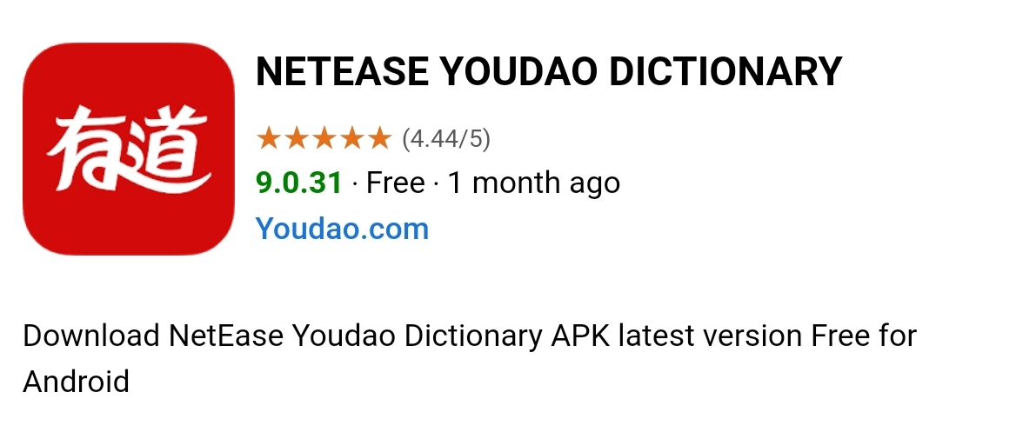
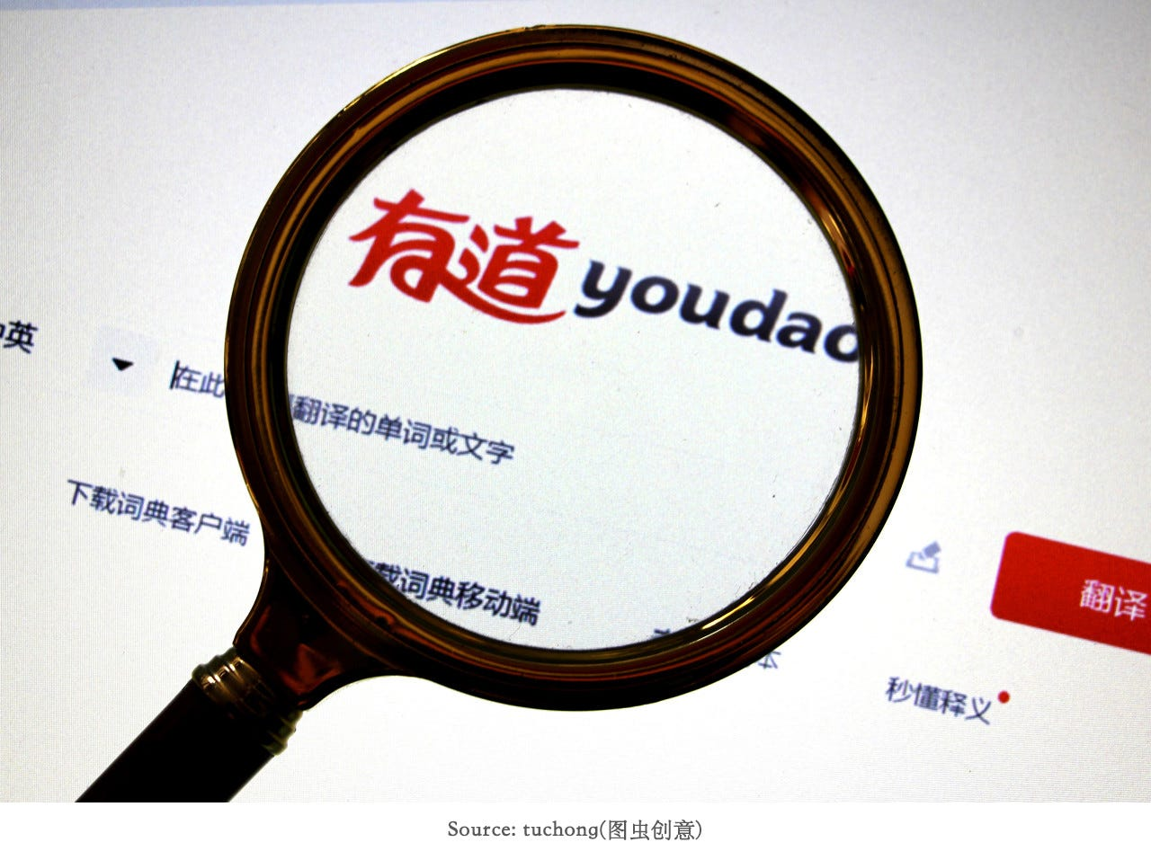
Research background
impact
Online dictionary learners’ receptive & productive vocabulary knowledge
Learners tend to over-trust in the validity of online dictionaries.
One of the most popular online dictionaries in China: Youdao dictionary
Is it truly reliable? Whether its efficacy would be compromised by potential inaccuracies or incomplete definitions?
Introduction
Methodology
Result & Discussion
Conclusion
Notes:
The pervasive influence of online dictionaries on second-language learners cannot be underestimated. They have become vital instruments in language learning, impacting learners’ vocabulary knowledge. It has been found that one of the most popular online dictionaries in China is Youdao dictionary, and students tend to over-trust in the validity of online dictionaries.
However, is it truly reliable? We are wondering whether its efficacy would be compromised by potential inaccuracies or incomplete definitions.

Slide 5
Research background
Previous study:
      learner’s L2 language proficiency
      learner’s dictionary skills
      technology issues of dictionary
affects
Learners’ perception and production of vocabulary by consulting e-dictionaries
      content reliability of dictionary？
research in this area is scarce.
The main purpose of this paper is to verify two hypotheses:
  H1: There is a prevalent tendency among Chinese students to heavily rely on electronic dictionaries, with minimal scrutiny of the accuracy or appropriateness of the provided results.
  H2: The potential inaccuracies present in online dictionaries may lead students to generate erroneous understandings in their second language.
Introduction
Methodology
Result & Discussion
Conclusion
Notes:
Previous studies have shed light on several factors influencing learners’perception and production of vocabulary when they are consulting e-dictionaries, including learner’s L2 language proficiency, dictionary skills, and technology issues of the dictionary itself.
However, regarding the issue of content reliability, past research has mainly focused on comparing and ranking various online dictionaries, rarely discussing specific faults in them and whether they affect users.
As a result, our study aims to identify common errors and deficiencies in the most popular electronic dictionary in China, and explore how these issues may affect undergraduate students’ vocabulary knowledge in the second language.

Slide 6
Ⅱ.
Methodology
Notes:
Next, I will briefly introduce the methodology we used.

Slide 7
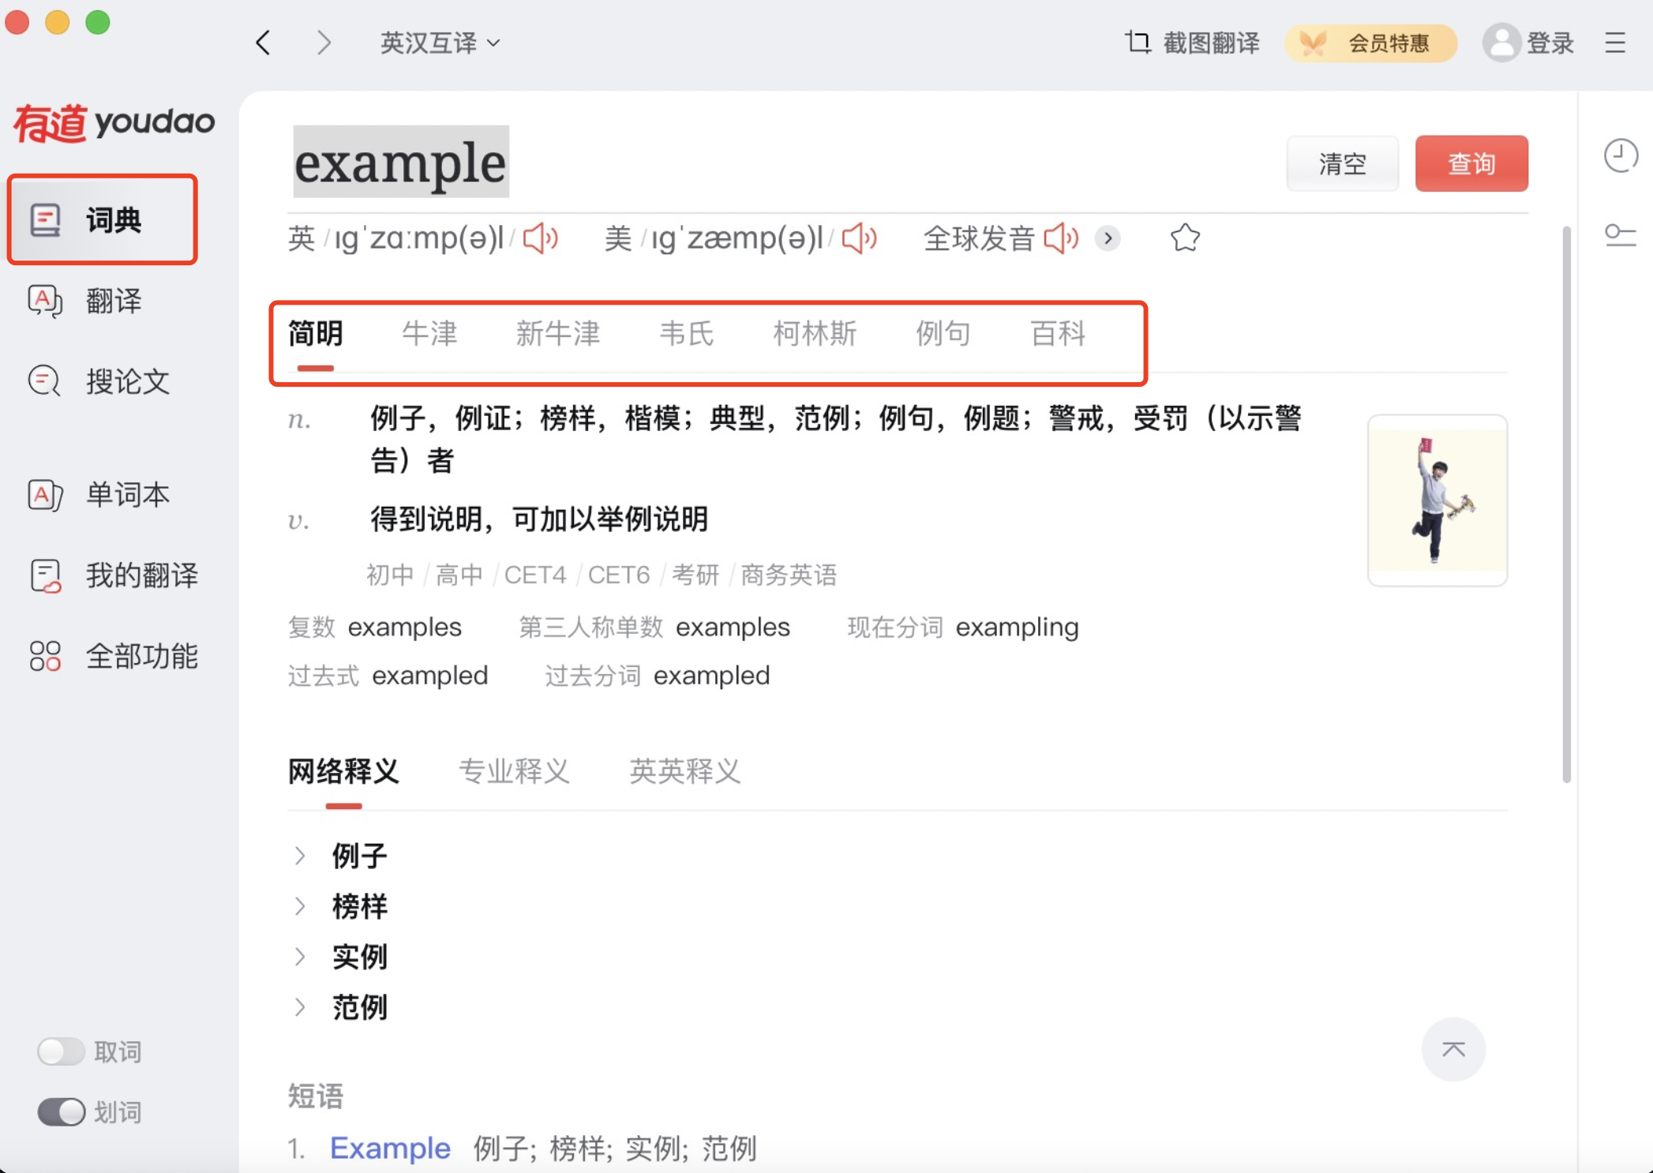

1. Concise dictionary (CD)
& authoritative dictionary (AD) in Youdao
New Oxford
Oxford
Webster
Collins
Concise dictionary
Authoritative dictionary
Introduction
Methodology
Result & Discussion
Conclusion
Notes:
This is the interface of Yodao dictionary. Five optional dictionaries are provided to users for consulting words. the latter four are the e-copies of some famous authoritative dictionaries embedded into Youdao platform, including Oxford, new Oxford, Collins, and Webster. Well, the first one is the concise dictionary, word entries in it are generated from extensive Internet resource, and it is the default page that users see first when they access the platform.
Our initial observation discovered that some word definitions in it are unreliable, so the concise dictionary is the targeted one in our research.

Slide 8
2. Research overview and participants
Method of this research has two parts:
  A short questionnaire survey
  A Translation experiment
Participants:
  105 undergraduates
  Native Chinese speakers
  > 97% scored above 130/150 in China’s NMET (National Matriculation English Test) fairly high English proficiency
Introduction
Methodology
Result & Discussion
Conclusion
Notes:
The method of this research has two parts, a short survey and a translation experiment.
We have 105 undergraduate participants. They’re all native speakers and over 97% have fairly high English proficiency.

Slide 9
3. Questionnaire design
A survey questionnaire consisting of three sections was developed.
To confirm the significance of studying the influence of dictionary accuracy on their learning.
Questionnaire
1. Participants’
background information
2. Usage habits of
Youdao dictionary
3. Overall attitudes
towards Youdao
Introduction
Methodology
Result & Discussion
Conclusion
Notes:
So how did we design the questionnaire? It has three sections: participants background information, their usage habits of Youdao dictionary, and their overal attitudes towards Youdao. This survey aims at confirming the significance of studying the influence of dictionary accuracy on students‘ learning.

Slide 10
4. Translation experiment
Freedom to worship our religion has been bought dearly.
The discussion is getting more and more furious.
He admitted that this problem is a main irritant.
They launch a vigorous movement to oppose corruption.
The two girls sloshed through the slurry with arms entwined.
Almost everyone in the audience felt this comedy was a bit raunchy.
Although my sister is not a doctor, she thinks she can cure any illness and is quick to suggest a nostrum to her friends.
I am a bit dicky today.
It is not just physicists who have a fetish for expensive machines.
He is one of the most nerveless champions in football history.
ten words with problematic Chinese definitions
hiding in ten
sentences respectively
furious | vigorous
dearly | fetish
raunchy | irritant
dicky | slosh
nostrum | nerveless
Voluntarily provided by undergraduate students;
unfamiliar words with frequencies lower than 1000 in COCA and BNC
Introduction
Methodology
Result & Discussion
Conclusion
Notes:
And about the translation experiment, some undergraduate students in our university voluntarily provided us with 10 words with problematic Chinese definitions in concise dictionary, they all have unfamiliarmeanings with frequencies lower than 1000 in COCA and BNC. And these words are hidden in 10 sentences respectively for participants to translate into Chinese.

Slide 11
5. Research procedure
Both the questionnaire and the translation experiment were conducted online.
All participants were required to share their screens with the researchers via Zoom for one-on-one observation.
1. Questionnaire
Participants’ background information
Usage habits of Youdao dictionary
Overall attitudes towards Youdao
2. Translation experiment
Only use the concise dictionary for consulting words
Only use authoritative dictionaries for consulting words
Introduction
Methodology
Result & Discussion
Conclusion
Notes:
So here is how our research went on
Bose, the questionnaire and the translation experiments I mentioned before were conducted online. Questionnaire first, then comes to the experiment. participants were required to share the screen while finishing them with researchers via zoom for one on one observation

Slide 12

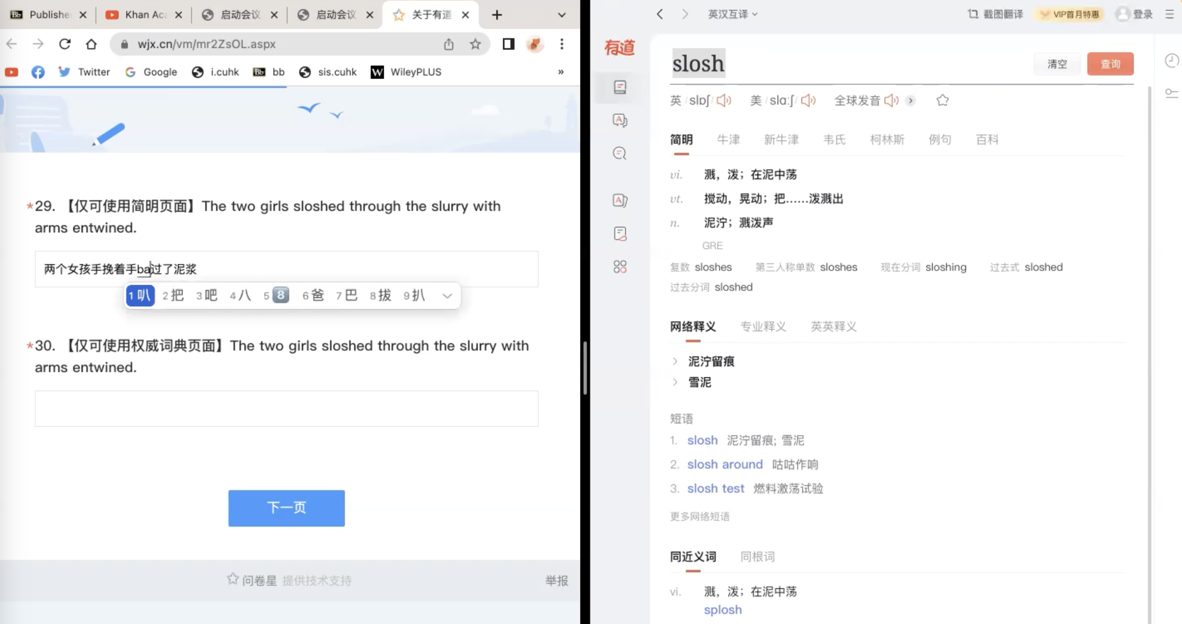
5. Research procedure: translation task
Students were required to translate each sentence twice.
In the first translation attempt, they referred to the concise dictionary (CD) only when encountering lexical problems.
[Use CD only ]
1st translation attempt
[definition in CD ]
Introduction
Methodology
Result & Discussion
Conclusion
Notes:
Specifically, for the translation task, students were required to translate each sentence twice in the first translation attempt , if they encountered lexical problems they can only refer to the concise dictionary

Slide 13
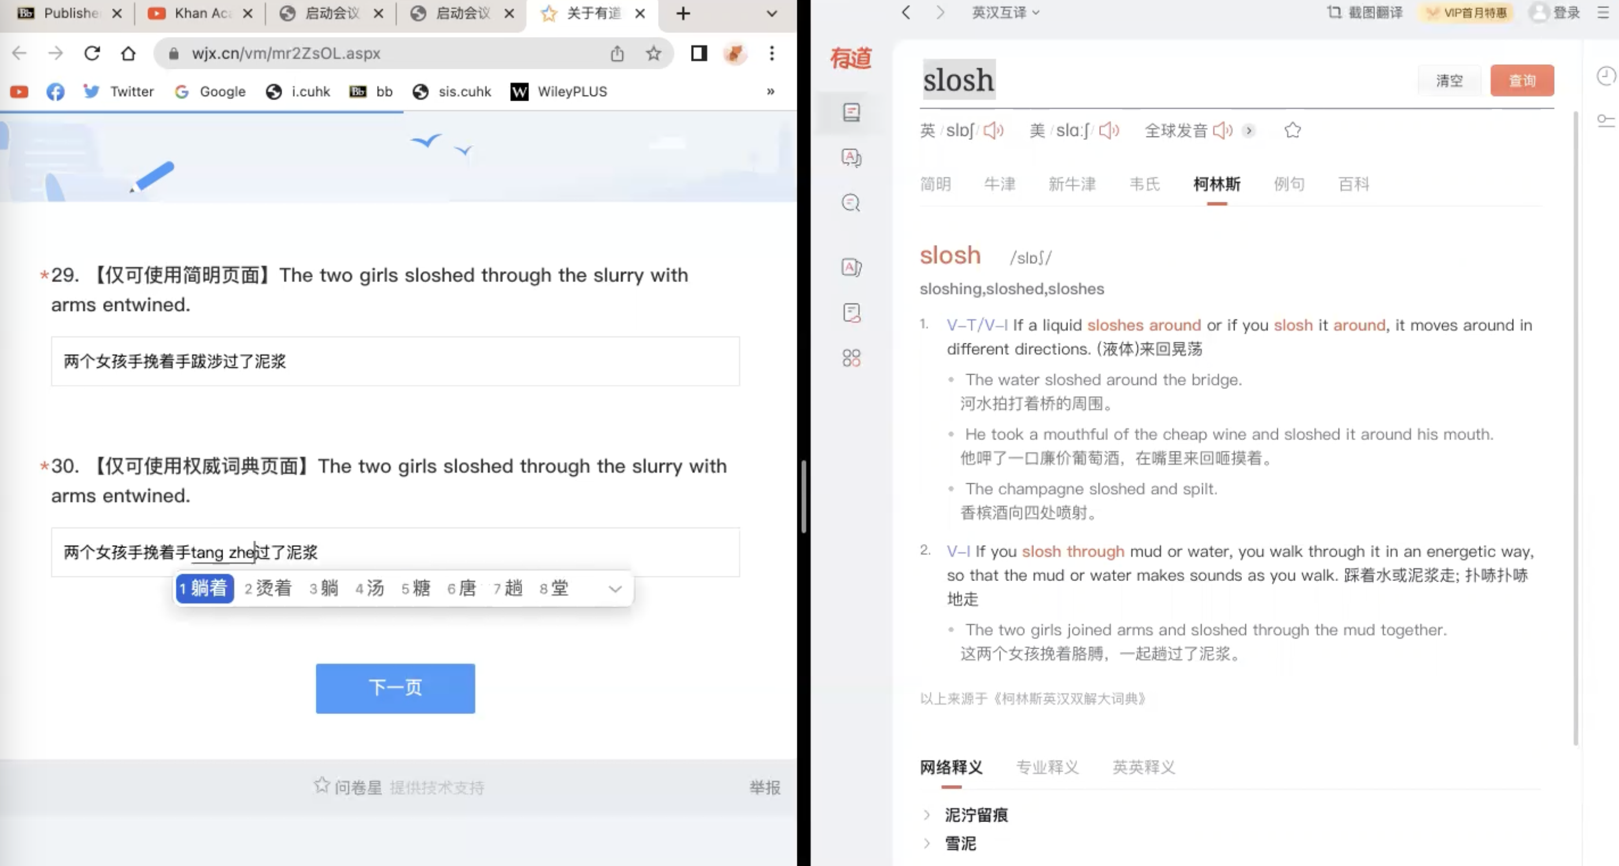
5. Research procedure: translation task
Students were required to translate each sentence twice.
In the second translation attempt, they referred to authoritative dictionaries (AD) only when encountering lexical problems.
[definition in AD ]
2nd translation attempt
[Use ADs only ]
Whether the definitions in two types of dictionaries would result in different understandings.
Introduction
Methodology
Result & Discussion
Conclusion
Notes:
And in the second translation attempt, they can refer to the authoritative dictionary one day don’t know some of the words
This process is to investigate whether the definitions in two types of dictionaries would result in different understandings

Slide 14
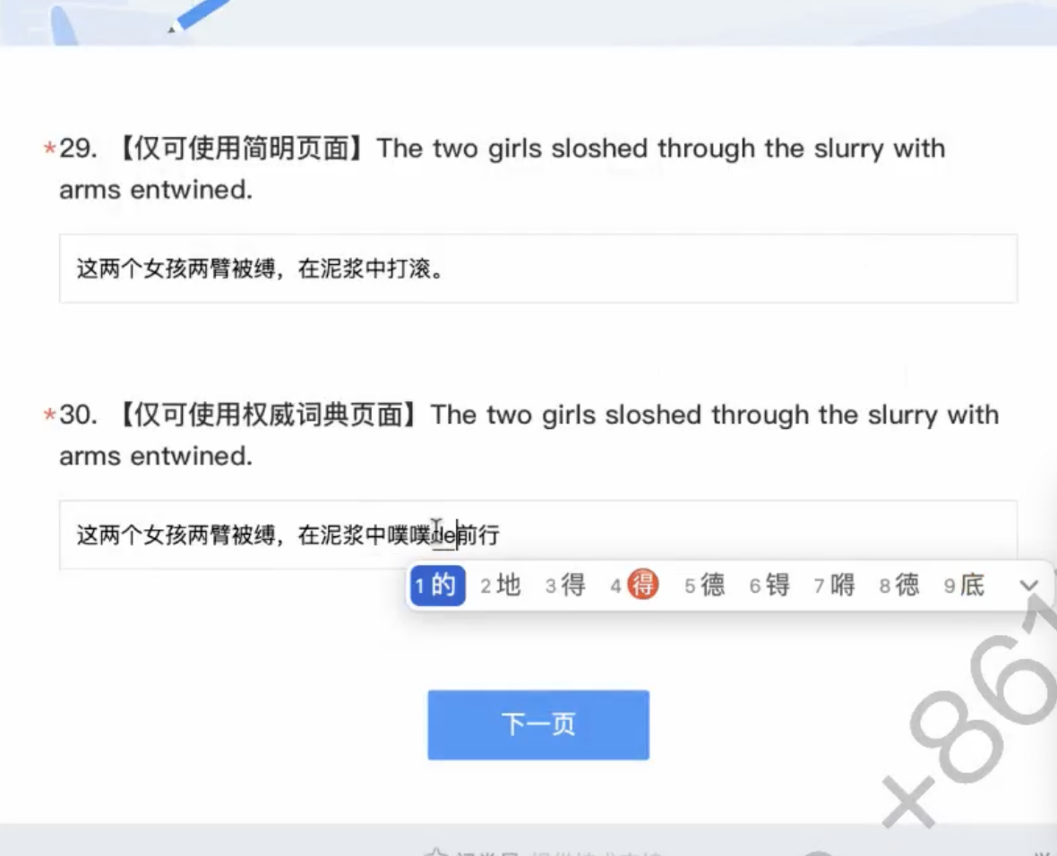
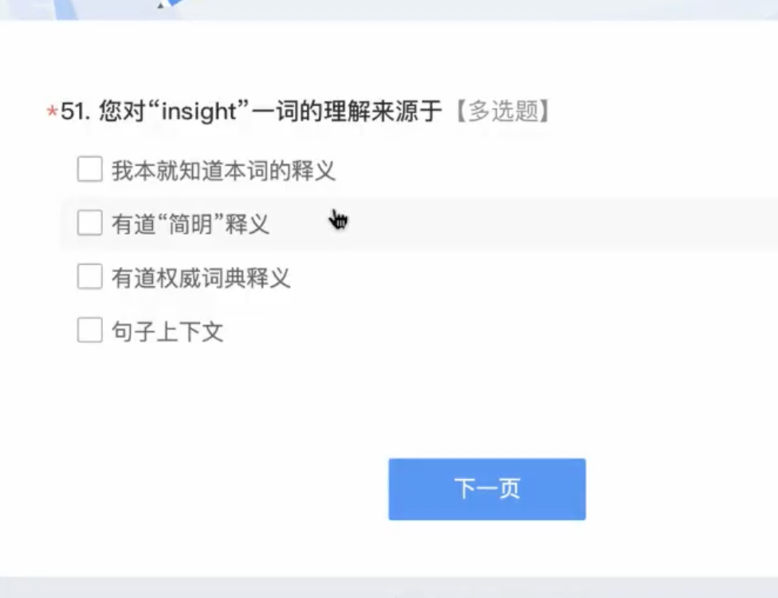
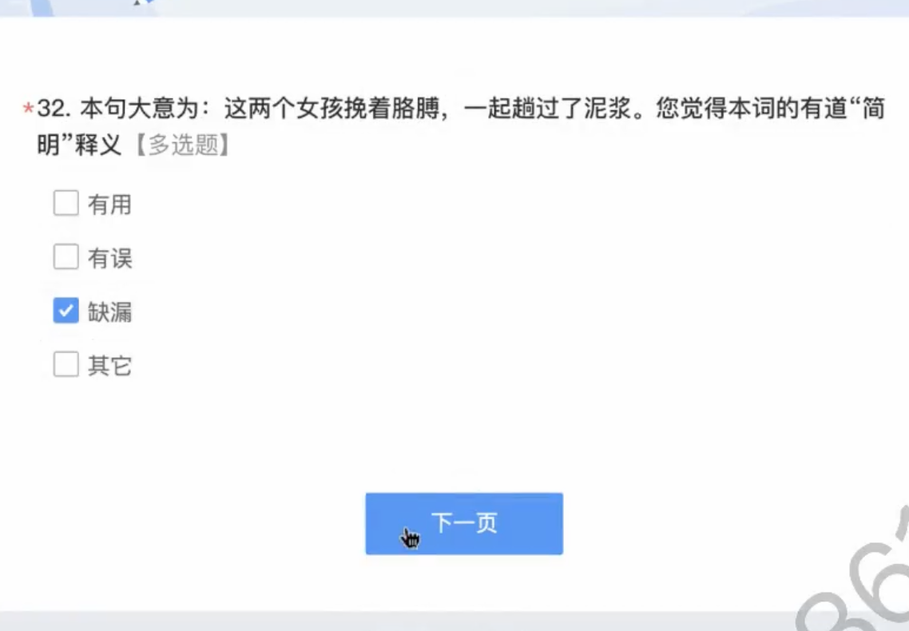
5. Research procedure: two introspective questions
1st introspective question
2nd introspective question
The accurate meaning of the sentence is 「…」.
In your opinion, the definition of 「target word」 given by CD is:
My understanding of 「target word」 is from:
Prior knowledge
helpful
CD’s definition
erroneous
ADs’ definition
deficient
Context
other
Students gave instant feedback on how they had determined the meaning of the target word.
By comparing the accurate answers with their own, students expressed their opinion on the quality of CD entries.
After translating each sentence twice:
Introduction
Methodology
Result & Discussion
Conclusion
Notes:
In addition, after they translate each sentence twice, we have two introspective questions for them.
The first question asked participants’ instant feedback on how they had determined the meaning of the target word, whether their understanding of the tested word was based on the CD, the ADs, the context, or their prior knowledge.
In the second introspective question, students were provided with the correct answers they had just worked on. By comparing it with their own, they expressed their opinion on the quality of CD entries.

Slide 15
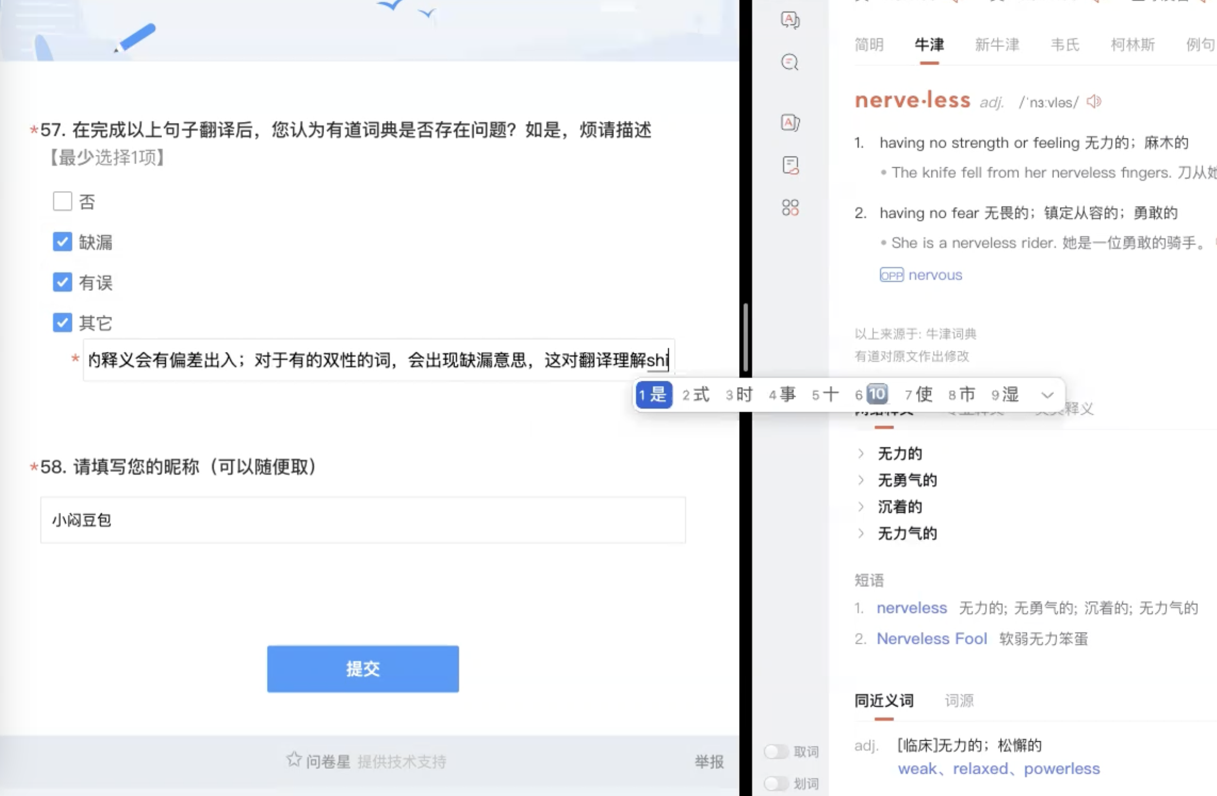
5. Research procedure: final question
Do you think Youdao dictionary have any problems?
In the end of the experiment,
Students are asked to provide their general feelings and evaluation for Youdao dictionary.
Elaborate your opinions here.
Introduction
Methodology
Result & Discussion
Conclusion
Notes:
Finally, positioned at the conclusion of the translation experiment, there was a final question for the participants that served as a comprehensive evaluation of the Concise Dictionary.

Slide 16
Ⅲ.
Results and
Discussion

Slide 17
1. Analysis of dictionary use
Data Sample
Analysis of dictionary use
Background question analysis
Chi-square test (cross-analysis)
Descriptive statistical analysis
Categorical summary analysis
105 questionnaires
12 background questions and 10 translation questions
12 factors and translation experiment performance correlation
Translations graded on 0-2 scale: 2=accurate, 1=partial, 0=wrong
Introduction
Methodology
Result & Discussion
Conclusion
Introduction
Methodology
Result & Discussion
Conclusion

Slide 18
1. 1 Background question analysis
Figure 1. Frequency of using Youdao
Figure 2. E-dictionary consultation use case
Youdao is a highly popular dictionary, about half using it multiple times a day. Chinese students tend to rely on E- dictionaries.
Most popular use scenario: reading.
Introduction
Methodology
Result & Discussion
Conclusion
Introduction
Methodology
Result & Discussion
Conclusion

Slide 19
1.1 Background question analysis
Figure 3. The most frequently used dictionary in listening and reading
Figure 4. Satisfaction with the definitions in the Concise Dictionary
Majority of the participants preferred using the concise dictionary for convenience.
Perception towards CD quality varies but the quality of CD definitions cannot keep up with users’ expectations.
Introduction
Methodology
Result & Discussion
Conclusion
Introduction
Methodology
Result & Discussion
Conclusion

Slide 20
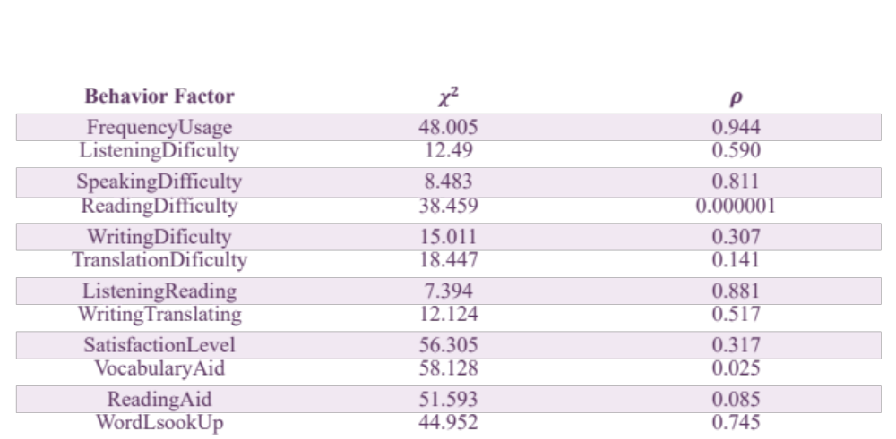
1.2 Chi-square test (cross-analysis)
Table 1. Chi-square analysis between behavior factor and total score
Behavior measured by the two factors impacts the participant’s translation performance.
Introduction
Methodology
Result & Discussion
Conclusion
Introduction
Methodology
Result & Discussion
Conclusion

Slide 21
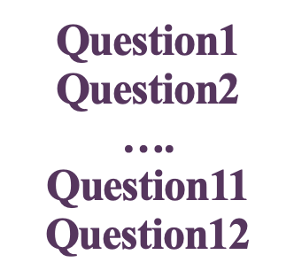
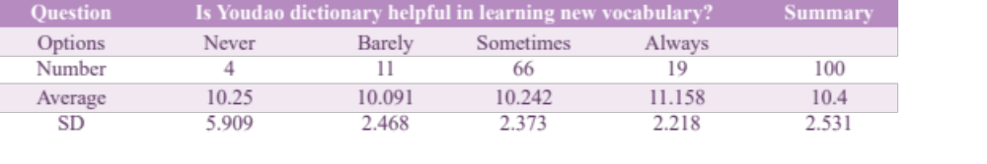
1.3 Descriptive statistical analysis
factors are segmented into various sub-categories
aggregated against the TotalScore metric
examined how they can impact the overall translation performance when using E-dictionaries
Total Score
Table 1. Descriptive statistical analysis
Introduction
Methodology
Result & Discussion
Conclusion
Introduction
Methodology
Result & Discussion
Conclusion

Slide 22
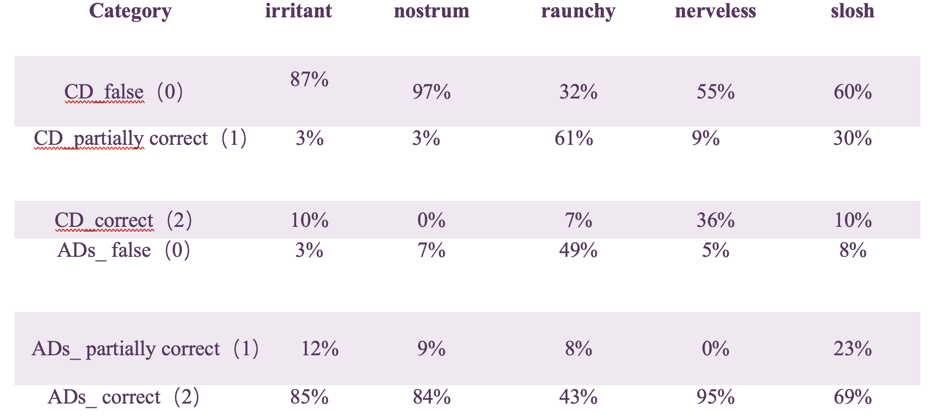
1.4 Categorical summary analysis
Table 2. Categorical summary analysis
Introduction
Methodology
Result & Discussion
Conclusion
Introduction
Methodology
Result & Discussion
Conclusion

Slide 23
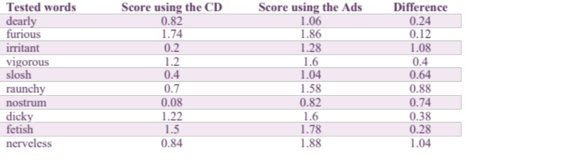
2. Overview of the translation performance
Table 3. Average point of the translation performance obtained through using two types of dictionaries
the average scores of 6 /10 tested words were below 1
2 scored between 1 to 1.5, and 2 scored higher than 1.5.
the average scores for all tested words increased after consulting the authoritative dictionaries.
the differences between consulting the two dictionaries ranged from 0.12 to 1.08.
Introduction
Methodology
Result & Discussion
Conclusion
Introduction
Methodology
Result & Discussion
Conclusion

Slide 24
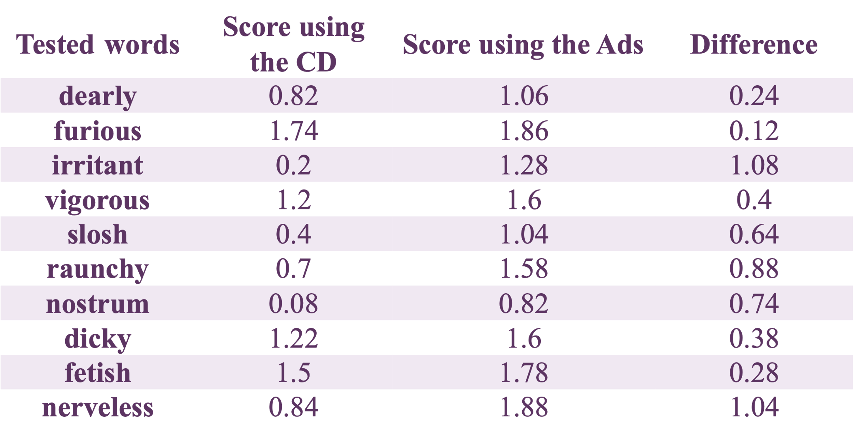
3. Analysis of the translation performance
Table 4. Average point of the translation performance obtained through using two types of dictionaries
Deficient
Incorrect
Confusing
Introduction
Methodology
Result & Discussion
Conclusion
Introduction
Methodology
Result & Discussion
Conclusion
Notes:
five words, irritant, slosh, raunchy, nostrum, and nerveless received the average score differences above 0.5. In order to explore the factors resulting in users’ underperformance when using the CD, their translation and the interface of looking up the tested words in the CD were examined.

Slide 25
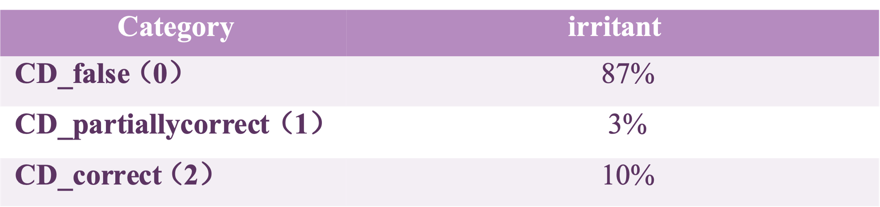
3 .1 Deficient definition：irritant
Reference answer:
He admitted that this problem was a main irritant.
他承认这个问题是让他恼火的主要原因。
ta cheng ren zhe ge wen ti shi rang ta nao huo de zhu yao yuan yin.
Table 5. Average point of the translation performance obtained through using two types of dictionaries
Table 6. Categorical summary analysis of irritant
Introduction
Methodology
Result & Discussion
Conclusion
Notes:
The disparity between the scores obtained by using the CD and ADs to aid in the comprehension of irritant is remarkable, with a significant difference of 1.08.
87% of participants misunderstood the word

Slide 26
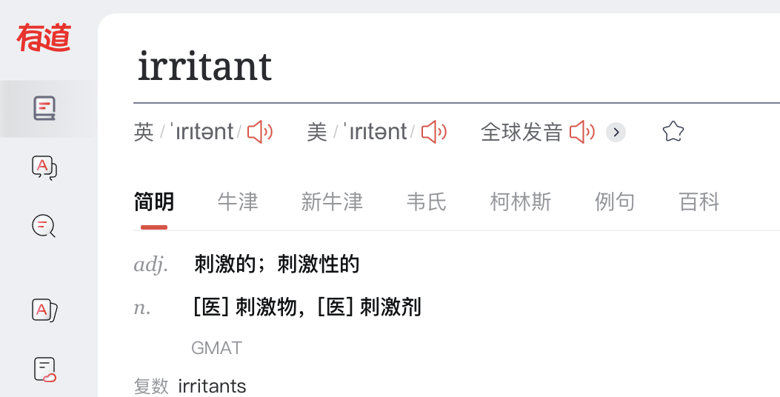
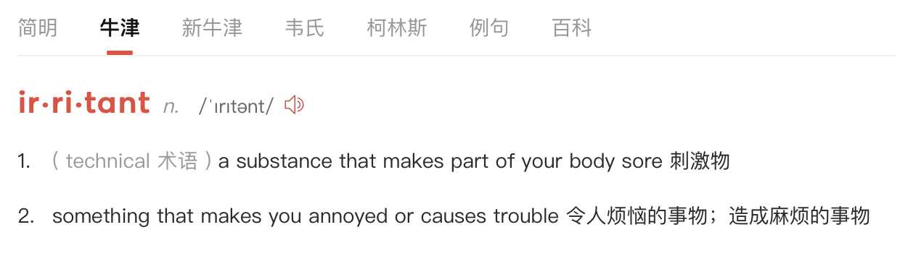


3 .1 Deficient definition：irritant
Figure 5. The entry of irritant in the concise dictionary
Figure 6. The entry of irritant in the Oxford Dictionary
Lacks the second sense：
“something that makes you annoyed or causes trouble.”
Introduction
Methodology
Result & Discussion
Conclusion

Slide 27
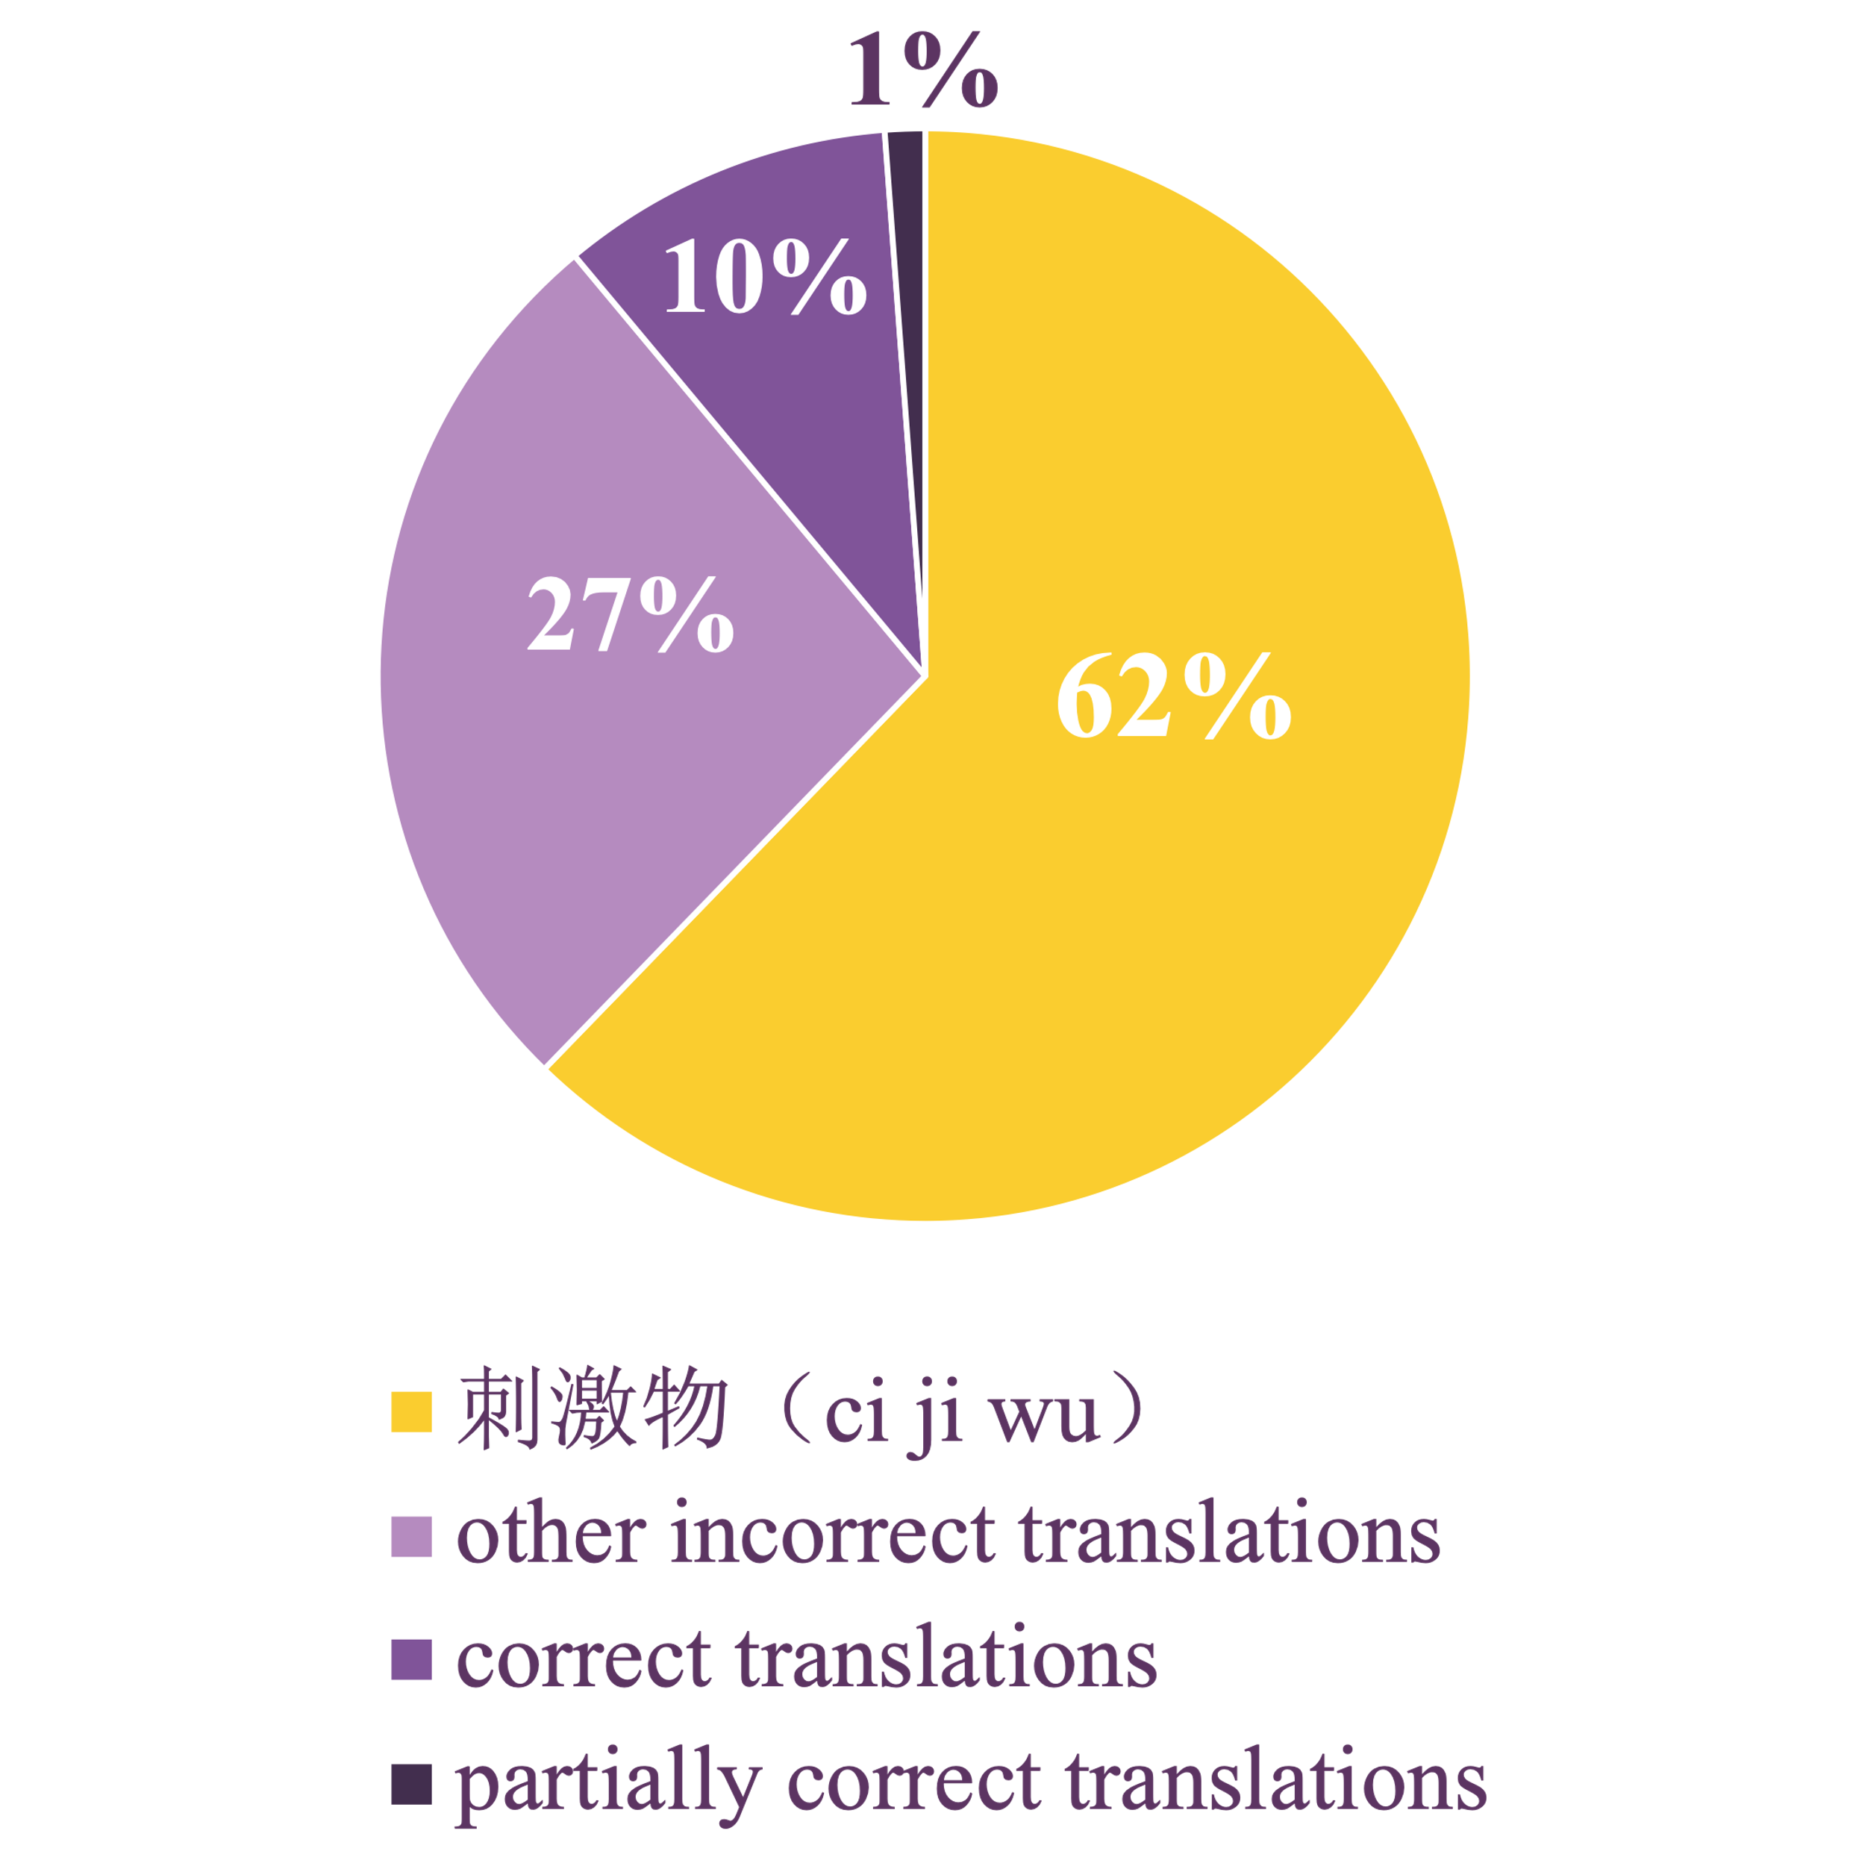
3 .1 Deficient definition：irritant
Reference answer:
He admitted that this problem was a main irritant.
他承认这个问题是让他恼火的主要原因。
ta cheng ren zhe ge wen ti shi rang ta nao huo de zhu yao yuan yin.
Participants’ translation:
他承认这个问题是一个主要的刺激物。
(ta cheng ren zhe ge wen ti shi yi ge zhu yao de ci ji wu.)
(He admitted that this problem was a main thing that stimulated him.)
Figure 7. Proportion of different translations of irritant
Introduction
Methodology
Result & Discussion
Conclusion

Slide 28
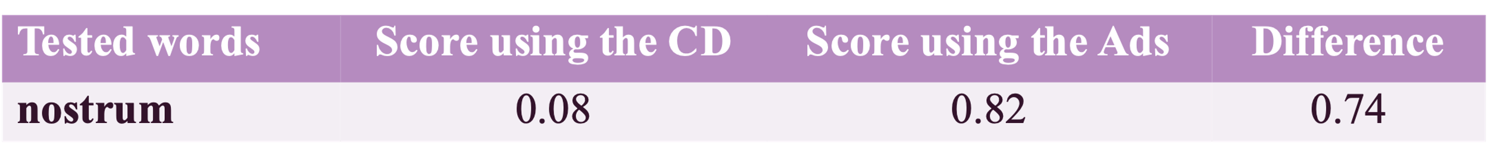
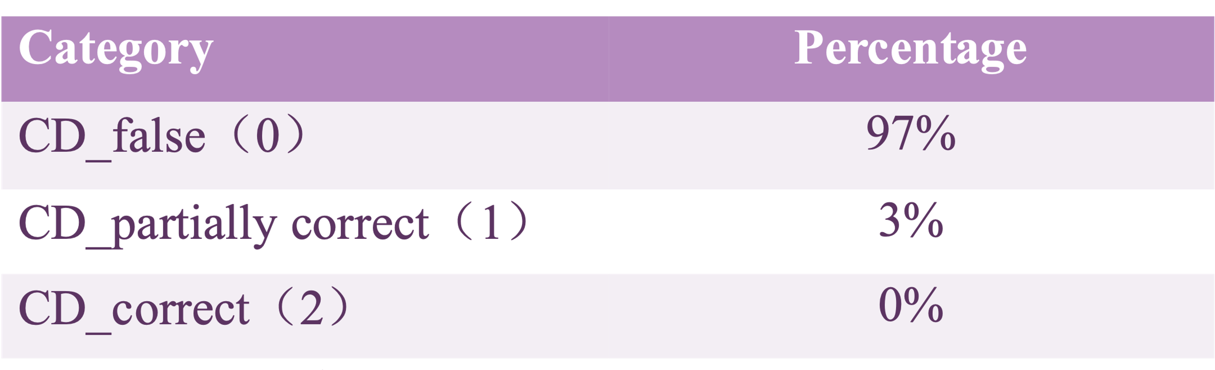
3 .2 Incorrect definition： nostrum
Reference answer:
Although my sister is not a doctor, she thinks she can cure any illness and is quick to suggest a nostrum to her friends.
虽然我姐姐不是医生，但她认为她可以治愈任何疾病，并且很快就向她的朋友推荐了一种江湖药。
sui ran wo jie jie bu shi yi sheng ，dan ta ren wei ta ke yi zhi yu ren he ji bing ，bing qie hen kuai jiu xiang ta de peng you tui jian le yi zhong jiang hu yao.
Table 7. Average point of the translation performance obtained through using two types of dictionaries
Table 8. Categorical summary analysis of nostrum
Introduction
Methodology
Result & Discussion
Conclusion

Slide 29
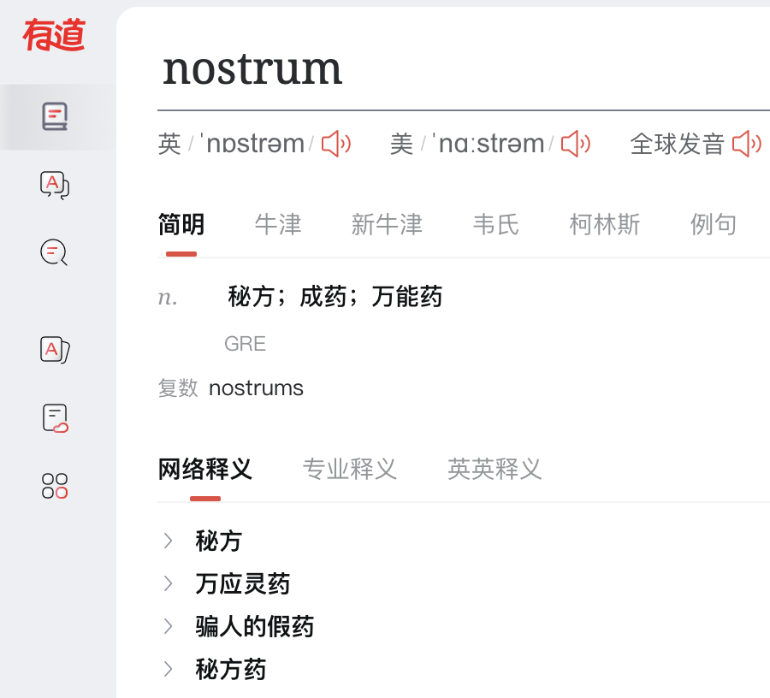
3 .2 Incorrect definition： nostrum
1.( formal disapproving) an idea that is intended to solve a problem but that will probably not succeed 并非灵验的招数；不会奏效的计策
2.(old-fashioned) a medicine that is not made in a scientific way, and that is not effective 江湖药
—— Oxford Dictionary
秘方(mi fang): an undisclosed prescription with a marked medical effect
万能药 (wan neng yao): panacea
骗人的假药(pian ren de jia yao): fraudulent medicine used to deceive people.
opposite
opposite
exaggerate
Figure 8. The entry of nostrum in the concise dictionary
Introduction
Methodology
Result & Discussion
Conclusion

Slide 30
3 .2 Incorrect definition： nostrum
Comments from the introspective questionnaire:
The definitions in the CD are contradictory with each other.
Its definition is confusing and not accurate.
The definition is not that correct, which is easy to cause misunderstanding.
Introduction
Methodology
Result & Discussion
Conclusion

Slide 31
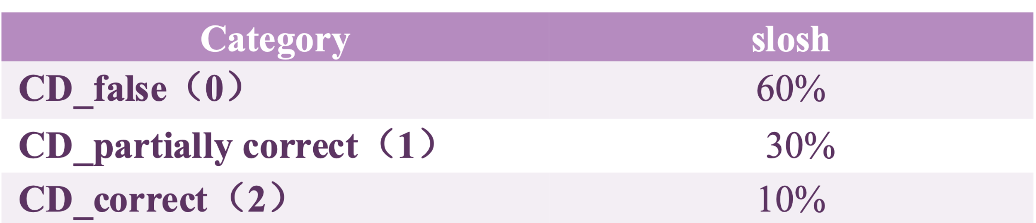
3 .3 Confusing definition：slosh
Reference answer:
The two girls joined arms and sloshed through the mud together.
这两个女孩挽着胳膊，一起趟过了泥浆。
zhe liangge nühai wan zhe gebo ，yiqi tang guo le nijiang.
Table 9. Average point of the translation performance obtained through using two types of dictionaries
Table 10. Categorical summary analysis of slosh
Introduction
Methodology
Result & Discussion
Conclusion

Slide 32
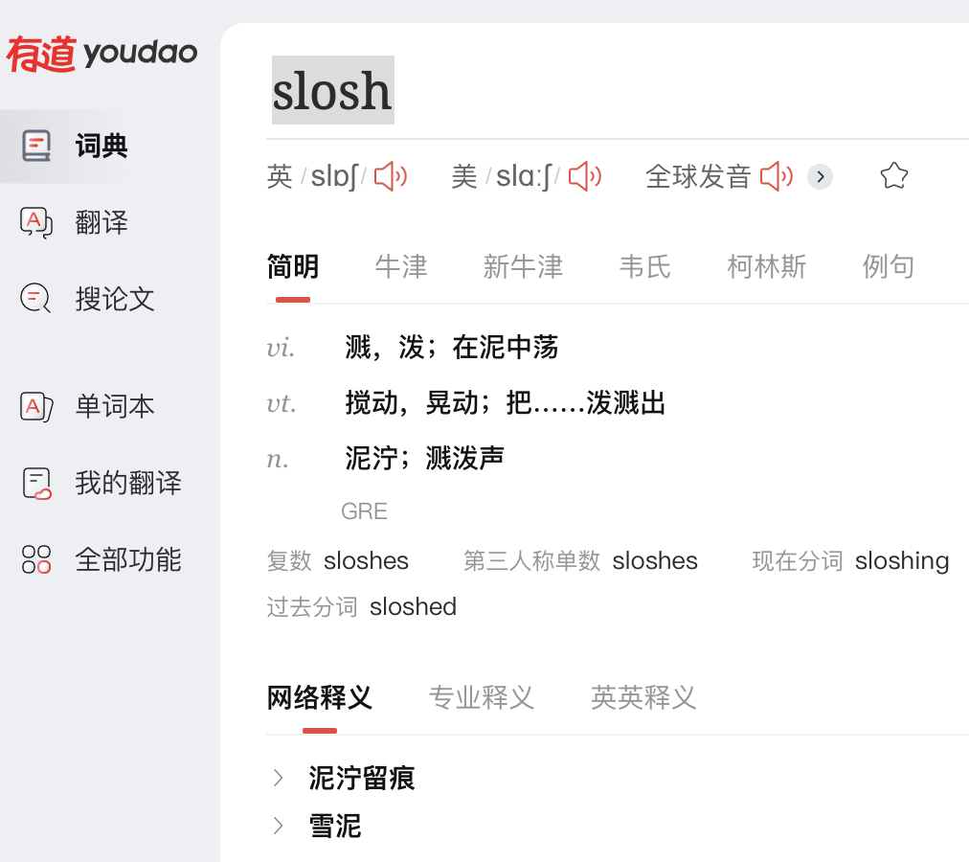
3 .3 Confusing definition：slosh
Comments from the introspective questionnaire:
The expression of its verb is hard to understand.
I had to use the context to paraphrase 泥中荡 (ni zhong dang, swing in the mud) into “wade into the mud”.
The Chinese phrase 在泥中荡(swing in the mud) misled me, making me misunderstand it as something like “stir”.
Figure 9. The entry of slosh in the concise dictionary
Introduction
Methodology
Result & Discussion
Conclusion

Slide 33
3 .3 Confusing definition：slosh
Reference translation:
The two girls joined arms and sloshed through the mud together.
这两个女孩挽着胳膊，一起趟过了泥浆。
zhe liangge nühai wan zhe gebo ，yiqi tang guo le nijiang.
Participants’ translation:
Paraphrase 在泥中荡：
这两个女孩挽着手臂在泥中荡着。
(zhe liang ge nü hai wan zhe shou bi zai ni zhong dang zhe.)
(The two girls swang in the slurry with arms entwined.)
这两个女孩挽着胳膊在泥浆中荡漾。
(zhe liang ge nü hai wan zhe ge bo zai ni jiang zhong dang yang.)
(The two girls rippled in the slurry with arms entwined.)
Seek help to the first sense：
两个女孩手臂交织着泼洒泥浆。
(liang ge nü hai shou bi jiao zhi zhe po sa ni jiang.)
(The two girls splashed the slurry with arms entwined.)
两个女孩相互缠绕手臂来搅动泥浆。
(liang ge nü hai xiang hu chan rao shou bi lai jiao dong ni jiang.)
(The two girls stirred the slurry with arms entwined.)
3.[V] to walk noisily in water or mud （在水或泥里）扑哧扑哧地走
—— Oxford Dictionary
Introduction
Methodology
Result & Discussion
Conclusion

Slide 34
4. Habits of E-dictionary use
Table 11. Average point of the translation performance obtained through using two types of dictionaries
Introduction
Methodology
Result & Discussion
Conclusion

Slide 35
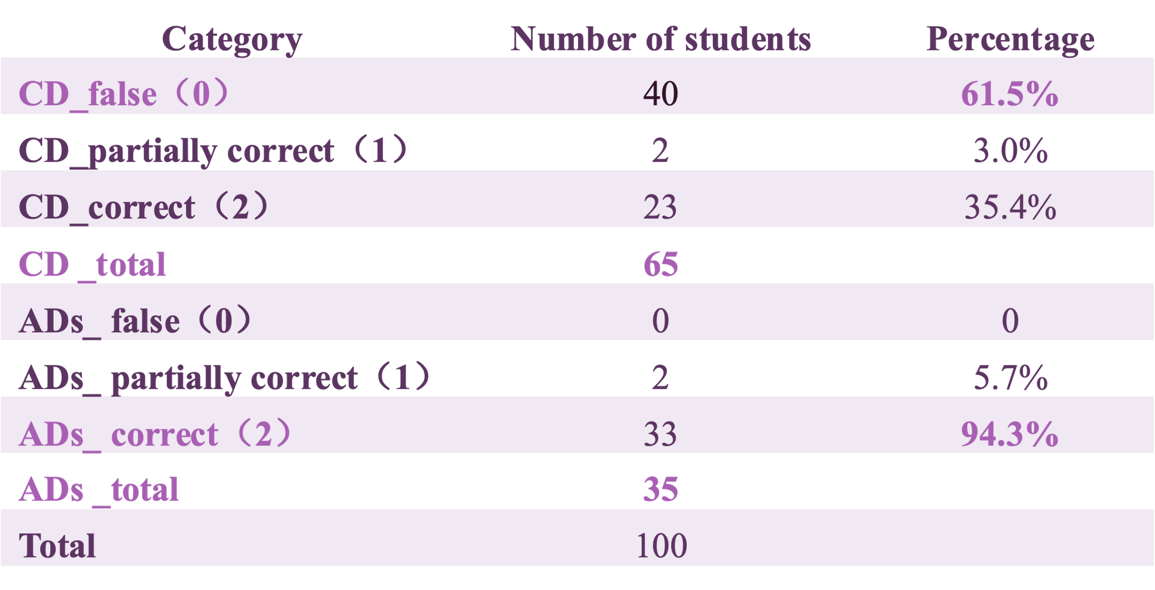
4.1 Being credulous with the concise dictionary - dearly
Table 12. Categorical summary analysis of dearly
Introduction
Methodology
Result & Discussion
Conclusion
Notes:
While we further analyzed the translation answers of all participants for dearly, it was found that 24 % of the assumed answers generated from using ADs were identical to the answers in the CD. These were all wrong answers with 0 marks, thus dragging down the average score of using the AD, as shown in Table 4. Due to the sequence design of the translation experiment, the question based on the use of CD was presented before the one using ADs, meaning that the participants might have directly copied their previous answers to the latter translations. This assumption was confirmed by retrieving the screen recordings of the process. Therefore, it could be concluded that the students had a trust in the CD, and thus skipped the use of ADs.

Slide 36
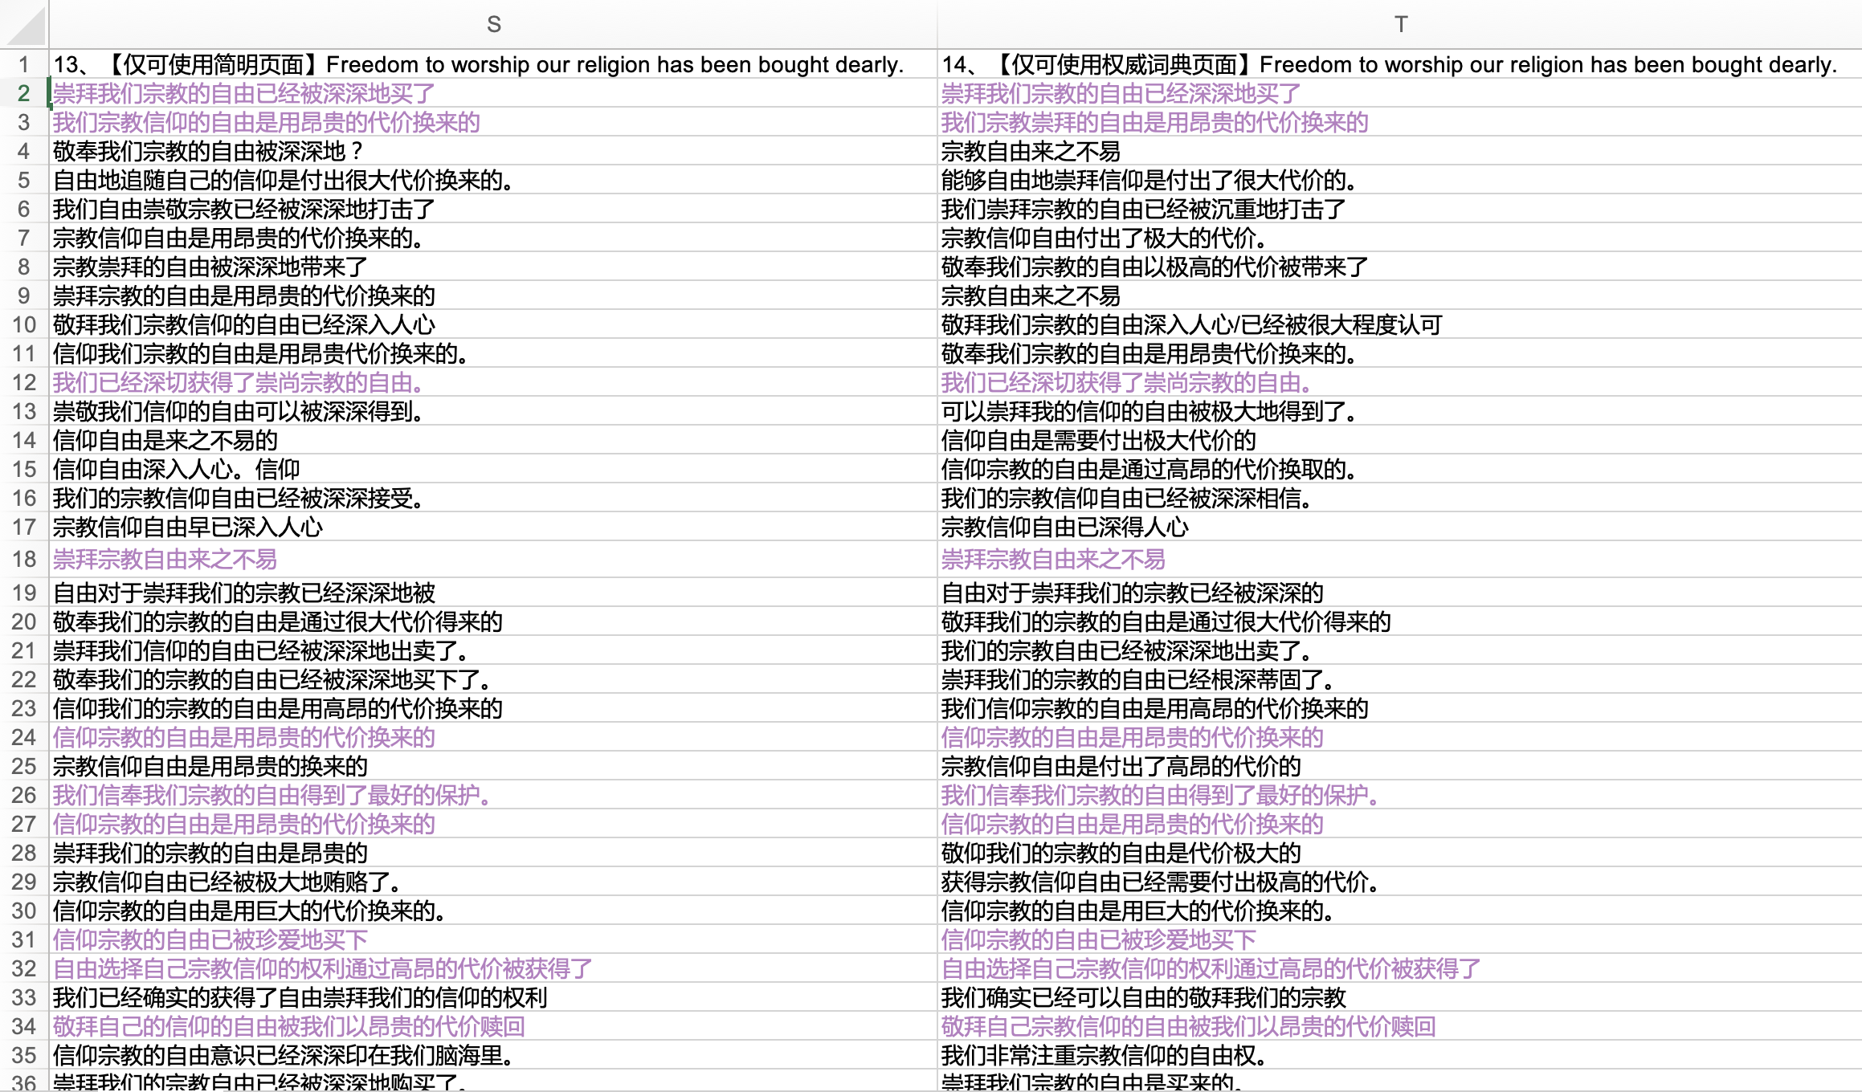
4.1 Being credulous with the concise dictionary - dearly
24 % of the assumed answers generated from using ADs were identical to the answers in the CD.
The participants directly copied their previous answers to the latter translations.
Figure 10. Screenshot of the translations of the sentence containing dearly
Introduction
Methodology
Result & Discussion
Conclusion

Slide 37
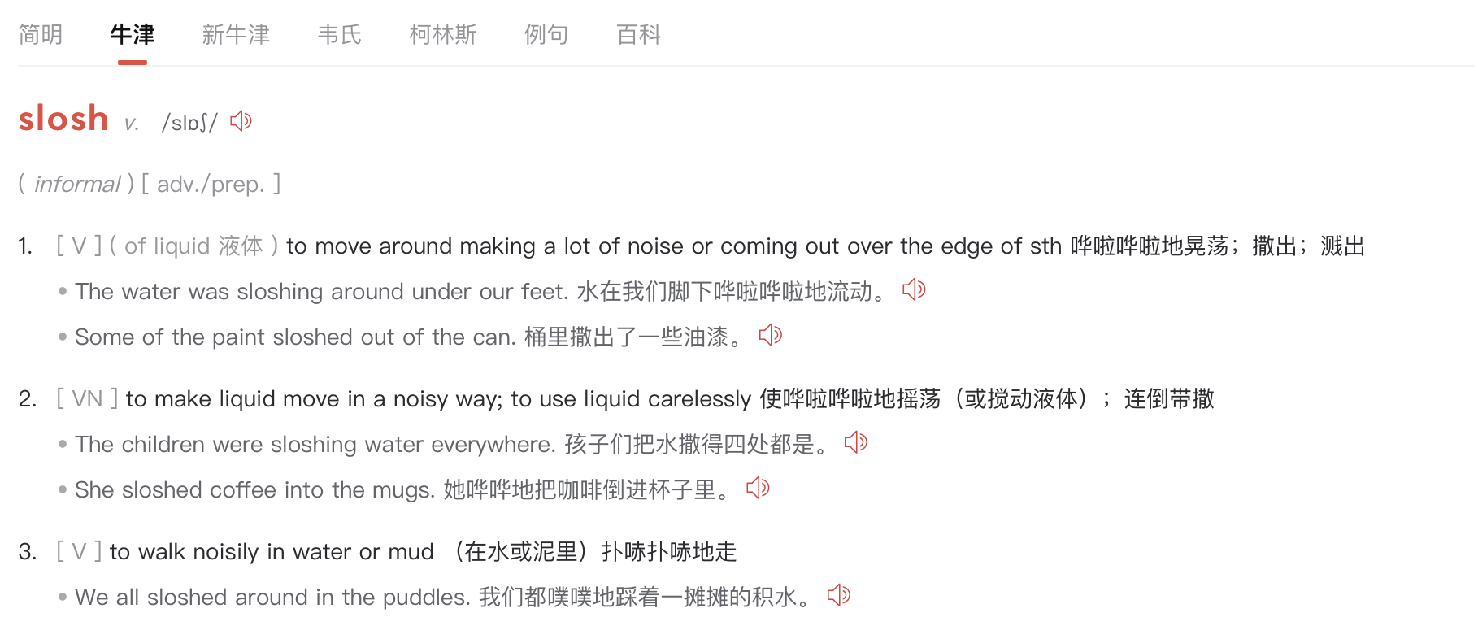
4.2 Referring to the first few definitions only
Dictionary users are prone to the first definition given for a polysemous word, even when it is not appropriate in the context (﻿Nesi & Haill , 2002 ).
The most suitable definition.
Figure 11. The entry of slosh in the Oxford Dictionary
Introduction
Methodology
Result & Discussion
Conclusion
Notes:
Upon reviewing the AD translation answers of the word slosh, we discovered that 32% of translations adopted the synonyms of the first and second senses in ADs, resulting in misunderstandings of the word slosh in the context. After retrieving the screen recordings, the assumption was confirmed that these students tended to hover their mouse pointers over the first and second senses for an extended period without noticing the third sense, which was the correct meaning. This finding supports the previous study conducted by ﻿Nesi & Haill (2002) that dictionary users are prone to the first definition given for a polysemous word, even when it is not appropriate in the context.

Slide 38
Ⅳ.
Conclusion

Slide 39
Conclusion
Youdao is predominantly used by its users with major reference to its Concise section.
The presence of erroneous, insufficient, and incomprehensible definitions in the CD could adversely affect students’ comprehension of words and sentences.
Students should develop good dictionary habits by consulting authoritative dictionaries more frequently and carefully read each sense to find the most suitable meaning.
It is crucial for dictionary developers to rectify all problematic definitions and provide high-quality assistance for word lookups.
Introduction
Methodology
Result & Discussion
Conclusion

Slide 40
References
Boonmoh, A. (2012). E-dictionary use under the spotlight: students' use of pocket. electronic dictionaries for writing. Lexikos, 22, 43-68.
Chon, Y. V. (2009). The electronic dictionary for writing: A solution or a problem?. International Journal of Lexicography, 22(1), 23-54.
Fageeh, Abdelaziz & Amin, Mohamed & Mekheimer, A. (2011). EFL Learners'. Vocabulary Acquisition in Translational Writing. Journal of Language Teaching and Research. 2. 10.4304/jltr.2.4.918-928.
Farina, D. M. C., Vrbinc, M., & Vrbinc, A. (2019). Problems in online dictionary use. for advanced Slovenian learners of English. International Journal of Lexicography, 32(4), 458- 479.
Ferrett, E., & Dollinger, S. (2021). Is digital always better? Comparing two English print dictionaries with their digital counterparts, International Journal of Lexicography, 34(1), 66– 91, https://doi.org/10.1093/ijl/ecaa016
Insights, G. (2019, August 22). NetEase Youdao goes all in on K12 education sector after the restructuring. Medium. https://edtechchina.medium.com/netease-youdao-goes-all-in-on-k12-education-sector-after-the-restructuring-cd37abb1edc6
Li, L., & Xu, H. (2015). Using an Online Dictionary for Identifying the Meanings of. Verb Phrases by Chinese EFL Learners. Lexikos, 25, 191-209.
Liu, D., Deng, Y., & Yang, S., (2021). Evaluating popular online English-Chinese. dictionaries in China by applying Lew and Szarowska’s (2017) evaluation
framework, International Journal of Lexicography, 34(2), 157
182, https://doi.org/10.1093/ijl/ecaa026
Nesi, H. (2002). A study of dictionary use by international students at a British University. International Journal of Lexicography, 15(4), 277–305. https://doi.org/10.1093/ijl/15.4.277
Introduction
Methodology
Result & Discussion
Conclusion

Slide 41
Q & A

